Slide 1
Loyalty-based Selection: Retrieving Objects That Persistently Satisfy Criteria
Computer Science and Engineering
Presented By: Zhitao Shen
Joint work with
Muhammad Aamir Cheema, Xuemin Lin
The University of New South Wales, Australia

Slide 2
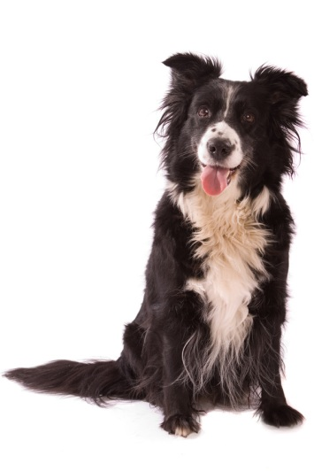
Introduction
Loyalty of an object
The loyalty of an object shows how long the object satisfying the given criteria during the last T time units.
Loyalty Queries
Find the objects satisfying the given criteria for the majority of the most recent time (top loyal objects).
Threshold Loyalty Queries
Top-k Loyalty Queries
Online processing.
Applications
location based services, wireless sensor network, stock market, traffic monitoring, internet applications, etc.
Notes:
For example, Iin a wireless sensor network, we may want to find two records with small time different but the readings are different.

Slide 3


Motivation
Example:
Car park advertising
  Find the cars appearing in the monitoring area for the majority of the recent time.
Monitoring Area

Slide 4


Preliminaries
Monitoring Area
Map objects to loyalty-time space.
Example:
2 objects;
top-1 loyalty query
Top loyal objects
Find the upper envelope
Loyalty
Echo Update
Update
Sliding Window (T)
Time
Sliding Window (T)
Notes:
Every object in sliding window should be kept. Why?

Slide 5
Contributions
Propose a novel measure, loyalty of the object, for a variety of applications.
First to study threshold and top-k loyalty queries over sliding windows.
The worst cost for processing each update is log (N), which is optimal.
Notes:
In practice k is small. Explain…..

Slide 6
Our Solution
Example:
Top-2 Loyalty Query
Top
Sweep line algorithm
1. Handle the updates
Create potential events
2. Handle the valid events
Create potential events
Border
Event Queue
Invalid
Bottom
Loyalty
U₂
U₃
U₅
U₆
Time
U₁
U₄

Slide 7
What else in the paper
We prove that the cost for processing each update is log (N)
We show that the lower bound cost for each update in the worst case is log(N). (optimality)
Pruning Rule
  Further ignore the unnecessary updates
  If the object is not possible to be a border object in the next D time, then the updates in the next D time can be ignored.

Slide 8
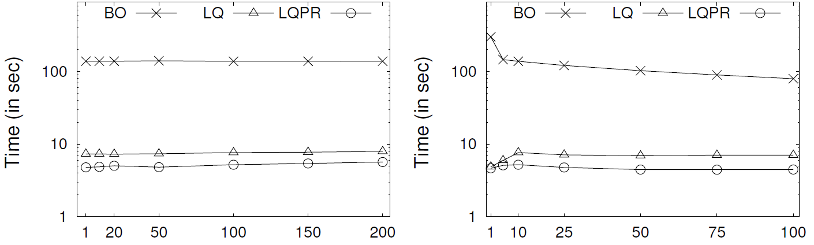
Experimental Settings
Synthetic data.
  a two state Markov chain Model
Compare with classic Bently-Ottmann algorithm (BO)
Varying k
Varying window size (x1000)

Slide 9
Question and Answer
Thank You!
Any Questions?

