Slide 1
A Safe Zone Based Approach for Monitoring Moving Skyline Queries
Computer Science and Engineering
Muhammad Aamir Cheema¹, Xuemin Lin^{2,1}, Wenjie Zhang¹, Ying Zhang¹
¹The University of New South Wales, Australia
² East China Normal University

Slide 2

Introduction
k-Nearest Neighbors (kNN) Query
Return k objects closest to the query point.
Skyline: A Multi-Criteria Query
Given a set of criteria, an object A dominates another object B if A is better than B for every criterion.
Return every object that is not dominated by any other object.
Distance | Price | Rating
5Km | $30 | ☺☺
Distance | Price | Rating
20Km | $30 | ☺☺
C
B
Is distance the only criterian???
A
Distance | Price | Rating
10Km | $20 | ☺☺☺☺

Slide 3
Introduction
Continuous Queries
Continuously monitor the results as the query moves.
E.g., Continuous kNN queries, continuous range queries, continuous reverse k nearest neighbors queries
In this paper, we study continuous skyline queries for moving query points where distance is one of the criterions.
Distance | Price | Rating
5Km | $30 | ☺☺
Distance | Price | Rating
15Km | $30 | ☺☺
Distance | Price | Rating
3.1Km | $30 | ☺☺
Distance | Price | Rating
20Km | $30 | ☺☺
Distance | Price | Rating
15Km | $30 | ☺☺
Distance | Price | Rating
4Km | $30 | ☺☺
C
B
We support arbitrary distance metric, e.g., Euclidean distance in 3d, road network distance
A
Distance | Price | Rating
5Km | $20 | ☺☺☺☺
Distance | Price | Rating
10Km | $20 | ☺☺☺☺
Distance | Price | Rating
3Km | $20 | ☺☺☺☺

Slide 4
Introduction
Solution Strategy
Assign query a safe zone such that
  results remain valid as long as query remains inside the safe zone
Re-compute the results only when query moves out of safe zone

Slide 5
Related Work
Continuous Skyline Queries
Huang et. al [TKDE 2006] and Lee et. al [ICDE 2009] (known velocities)
Tian et. al [MOBIDE 2007] (moving objects, static query)
Hsueh et. al [DEXA 2008] (designed for small update ratio)
Safe zone based approaches for other queries
kNN queries: Zhang et. al [SIGMOD 2003], Nutanong et. al [PVLDB 2008] , Hasan et. al [SSTD 2009]
Range queries: Zhang et. al [SIGMOD 2003] and Cheema et. al [ICDE 2010]
Group NN queries: Li et. al [ICDE 2013]

Slide 6
Solution Overview
Solution Strategy
Compute safe zone and the query results
  results remain valid as long as query remains inside the safe zone
Re-compute the safe zone and results when query moves out of safe zone
How to compute the safe zone?

Slide 7

Formalizing Safe Zone
An object A is a skyline object if and only if there does not exist any object X better than A on every dimension, i.e.,
An object A is a skyline if and only if, for each object X that is better than A in every static dimension
  A is better than X in dynamic dimension (distance), i.e., A is closer to q than X
A
B
E
Ranking
D
E
A
C
B
q
C
D
Price
Location coordinates
Static dimensions

Slide 8
Formalizing Safe Zone
An object A remains a skyline object as long as it is closer to q than every such object X
Impact region of an object A is the area such that A is a skyline object if and only if q is inside this area
An object A is a skyline object if and only if there does not exist any object X better than A on every dimension, i.e.,
For each object X that is better than A in every static dimension
  A is better in dynamic dimension (distance), i.e., A is closer to q than X
An object A remains a skyline object as long as it is closer to q than every such object X
A
B
E
Ranking
D
E
A
C
B
q
C
D
Price
Location coordinates
Static dimensions

Slide 9
Formalizing Safe Zone
An object A remains a skyline object as long as it is closer to q than every such object X
Impact region of an object A is the area such that A is a skyline object if and only if q is inside this area
Impact region of Y = Voronoi Cell of Y computed using Y and the objects that are better than Y on every static dimension
A
B
E
Ranking
D
E
A
C
B
q
C
D
Price
Location coordinates
Static dimensions

Slide 10

Formalizing Safe Zone
Impact region of Y = Voronoi Cell of Y computed using Y and the objects that are better than Y on every static dimension
Y is a skyline object if and only if q is in the impact region of Y
Note that result remains unchanged as long as q does not enter (or leave) an impact region
Safe Zone = IR(D) ∩ IR(C) ∩ IR(A) - IR(B) – IR(E)
IR(E)
IR(D) = IR(C)
IR(B)
A
B
E
Ranking
D
E
A
C
B
IR(A)
q
C
D
Price
Location coordinates
Static dimensions

Slide 11
A Basic Algorithm
Z = whole data space
For each object o
  Compute impact region IR (o) of o
  If q is inside IR(o) // o is a skyline object
    Z = Z ∩ IR(o)
  Else
    Z = Z – IR(o)
Return Z
←
←
A
B
E
Ranking
D
E
A
C
B
q
C
D
Price
Location coordinates
Static dimensions

Slide 12
A Basic Algorithm
Find the objects that are better than o in every static dimension
Compute Voronoi cell of o using o and these objects
Z = whole data space
For each object o
  Compute IR (o)
  If q is inside IR(o) // o is a skyline object
    Z = Z ∩ IR(o)
  Else
    Z = Z – IR(o)
Return Z
A
B
E
Ranking
D
E
A
C
B
q
C
D
Price
Location coordinates
Static dimensions

Slide 13
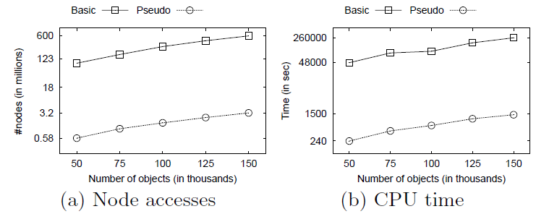
Optimization: Pseudo-Impact Region
Z = whole data space
For each object o
  Compute IR (o)
  If q is inside IR(o) // o is a skyline object
    Z = Z ∩ IR(o)
  Else
    Z = Z – IR(o)
Return Z
Find the objects that are better than o in every static dimension
Compute Voronoi cell of o using o and these objects
Find the skyline objects that are better than o in every static dimension
Compute Voronoi cell of o using o and these objects
Advantages
Have to look only in the set of skyline instead of the whole data set
Voronoi cell computation becomes cheaper (due to fewer objects)
A
B
E
Ranking
D
E
A
C
B
q
C
D
Price
Location coordinates
Static dimensions

Slide 14
Other optimizations: highlights
Z = whole data space
For each object o
  Compute IR (o)
  If q is inside IR(o) // o is a skyline object
    Z = Z ∩ IR(o)
  Else
    Z = Z – IR(o)
Return Z
Prune un-necessary objects
For Euclidean Space
Extend pruning rules for R-tree
Efficiently compute psuedo-impact regions using R-tree

Slide 15
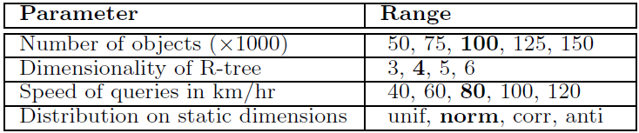
Experimental Settings
Dataset
  Real data set containing 175,813 POIs in North America
  Static attributes are synthetically generated
  Query points belong to cars moving on road network (using Brinkhoff data generator)
  100 queries are generated and each query is monitored for 5 minutes. Figures report the total cost for all queries.

Slide 16
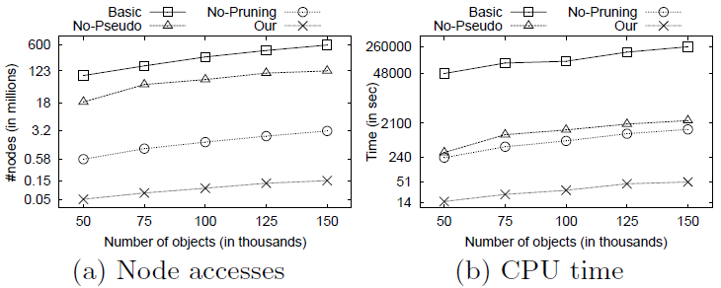
Experiments (effect of optimizations)
Basic: The basic algorithm
No-Pseudo: The optimization that uses psuedo-impact regions is not used
No-Pruning: The pruning rules are not used
Our: The optimization and pruning rules are applied

Slide 17
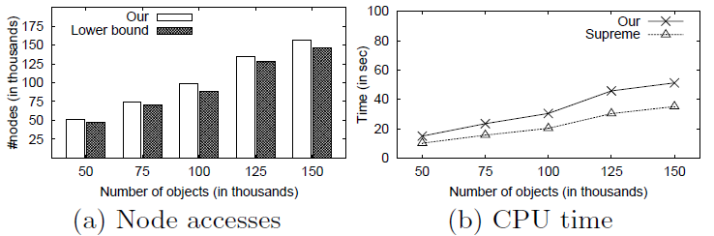
Experiments (effect of data cardinality)
Supreme:
Compute skyline objects using BBS SIGMOD[2003] (an IO optimal algorithm)
Compute safe zone using an oracle (zero cost)
Repeat 1 and 2 whenever query leaves the safe zone
Note: The IO cost of Supreme is the lower bound IO cost

Slide 18
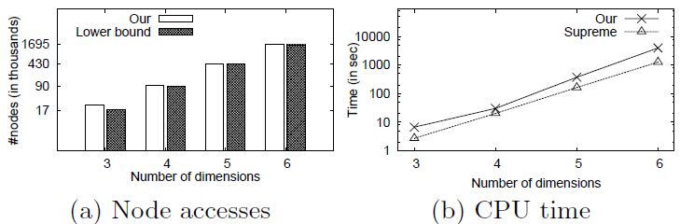
Experiments (effect of dimensionality)

Slide 19
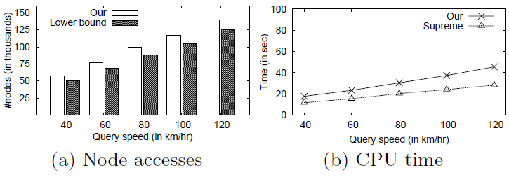
Experiments (effect of query speed)

Slide 20
Thank You!
Any Questions?

