Slide 1
A Uniﬁed Framework for Efﬁciently Processing Ranking Related Queries
Muhammad Aamir Cheema¹, Zhitao Shen², Xuemin Lin², Wenjie Zhang²
¹ Monash University, Australia
² University of New South Wales, Australia

Slide 2
Outline
Dual mapping and ranking
K-lower envelope and its application in ranking
Our contributions
Highlights of our algorithms
Experimental results
Conclusions and future work

Slide 3
Dual mapping and ranking
Given a point a=(u,v) and a weighting vector W=(w₁, w₂), a.score = u*w₁ + v*w₂
A point a=(u,v) is mapped to a line a*: y=ux + v in dual
The weighting vector W=(w₁, w₂) is mapped to a vertical line W*: x=w₁/w₂
The intersection of a* and w* is the point where y= u(w₁/w₂)+ v = (u*w₁ +v*w₂₎)/w₂
W*: x = w₁/ w₂
b*
a
y_{b}= b.score/w₂
a*
b
y_{a}= a.score/w₂
Primal
Dual

Slide 4
Ranking in dual space
Example Query: Given a weighted vector W=(w₁,w₂), return k objects with smallest scores
Solution:
  Map W and all the objects to dual space
  Return k lowest lines intersecting W*
Rank
d
b
a
c
Rank
a
b
c
d
W*: x = w₁/ w₂
W*: x = w₃/ w₄
c
d
a
2
1
b
Primal
Dual

Slide 5
k-lower envelope
Given a set of lines L, mass of a point p is the number of lines that lie strictly below p
k-lower envelope consists of every point p that lies on one of the lines in L and has mass equal to k-1.
2-lower envelope
p
p’

Slide 6
k-lower envelope and ranking
Top-k queries: Any top-k query involving any linear scoring function can be answered using k-lower envelope.
c
d
a
b
Primal
Dual

Slide 7
k-lower envelope and ranking
Reverse top-k query: Given an object q, return the set of weighted vectors for which q is one of the top-k objects.
Applications: Identify the users that may prefer the product q
Solution: Compute the intersection between q* and k-lower envelope
W*: x = w₁/ w₂
c
d
a
q
b
Primal
Dual

Slide 8
k-lower envelope and ranking
k-snippet: Return all valuable objects where an object o is called valuable if it is among top-k objects for at least one scoring function
Applications: A data summary such that every top-m (m≤k) query can be answered using this summary.
Solution: Return objects that lie on or below k-lower envelope
f
e
c
d
a
b
Primal
Dual

Slide 9
k-lower envelope and other applications
k-depth contour: Return an area such that an object o is valuable if and only if o is outside this area
  Ranking
  Outlier detection
  Reverse k furthest neighbors
  And more
Voronoi-diagrams
Half-space range searching
and more …

Slide 10
Existing work
k-lower envelope
k-depth contour
reverse top-k queries

Slide 11
Our contributions
Existing algorithms to compute k-lower envelope
  assume data can fit in main memory
  are index-agnostic
We propose two efficient index-aware secondary memory algorithms
  SkyRider – I/O and CPU efficient algorithm
  KnightRider – I/O optimal
As a result of above, we are able to compute
  k-snippet (I/O optimal)
  k-depth contour (I/O optimal when node size > k)
  Reverse top-k query (up to two orders of magnitude better than state-of-the-art)

Slide 12
Rider: The Basic Idea
Start from the left most point on k-lower envelope (always move towards right)
Upon reaching an intersection
  Make a turn (i.e., leave the current road)
The path travelled is the k-lower envelope
c
d
a
b
Primal
Dual

Slide 13
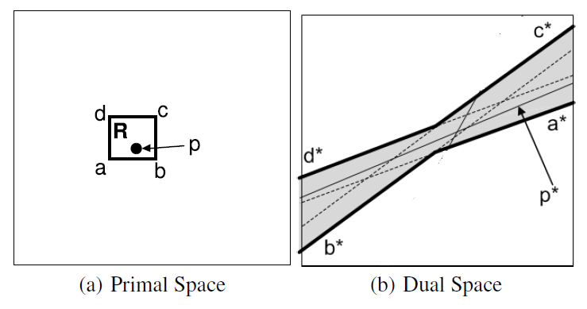
Implementing Rider
Start from the left most point on k-lower envelope (always move towards right)
Upon reaching an intersection
  Make a turn (i.e., leave the current road)
The path travelled is the k-lower envelope
Line with k-th largest slope.
i.e., point in primal with k-th largest x-value
c
d
A point (u,v) in primal is
mapped to a line y=ux+v
a
b
Primal
Dual

Slide 14
SkyRider: An I/O efficient version of Rider
Main observation: Only the points in primal space that are among k-skyband points are required to compute k-lower envelope
Algorithm:
  Compute k-skyband using BBS
  Run Rider on k-skyband

Slide 15
KnightRider: An I/O optimal algorithm
Must-first paradigm
An entry is called a must entry, if the correctness cannot be guaranteed without accessing it.
Algorithm
Insert root node of R-tree in Q
While Q is not empty
  Access the entries in Q
  Compute two approximations of k-lower envelope using accessed entries
  Q ← the unaccessed must entries
Return k-lower envelope

Slide 16
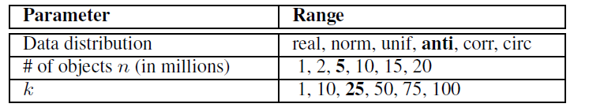
Experiments: Data
Real data
  5 Million POIs on the road network of California
  Each POI has two attributes: distance to nearest beach, distance to nearest airport
Synthetic data

Slide 17
Experiments: Competitors
BELT [H. Edelsbrunner and E. Welzl, “Constructing belts in two dimensional arrangements with applications,” SIAM J. Comput., 1986]
FDC [T. Johnson, I. Kwok, and R. T. Ng, “Fast computation of 2-dimensional depth contours,” in KDD, 1998]
FDC-Index (same as FDC but uses Index for computing convex hull)

Slide 18
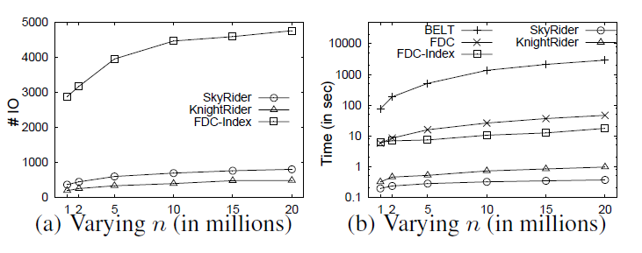
Experiments: Results
Effect of data size

Slide 19
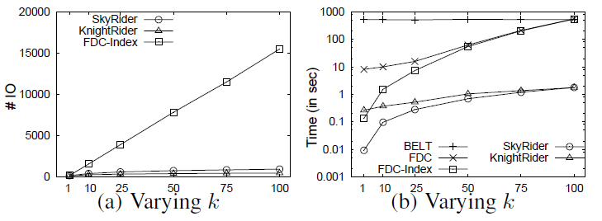
Experiments: Results
Effect of k

Slide 20
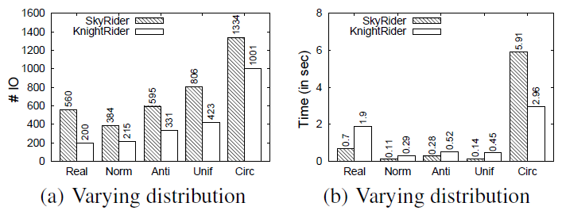
Experiments: Results
Effect of data distribution

Slide 21
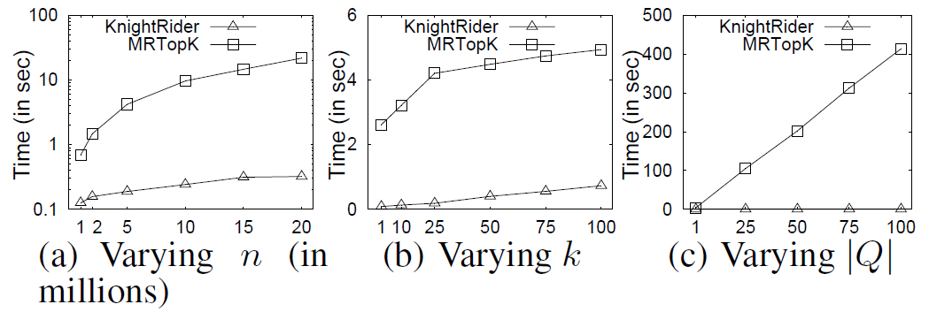
Experiments: Results
Reverse top-k queries
MRTopK [A. Vlachou, C. Doulkeridis, Y. Kotidis, and K. Nørvåg, “Reverse top-k queries,” in ICDE, 2010]

Slide 22
Conclusions and Future Work
Contributions
First to study index-aware algorithm for k-lower envelope with applications in ranking related queries
Propose two efficient algorithms SkyRider and KinghtRider
Proof of I/O optimality
Algorithms are extendible to higher dimensionality
Future work
Propose approximate but efficient algorithms for higher dimensionality

Slide 23

aamir.cheema@monash.edu
http://users.monash.edu.au/~aamirc
Twitter handle: @cheema154

