Slide 1
Diversified Spatial Keyword Search On Road Networks
Computer Science and Engineering
Chengyuan Zhang¹,Ying Zhang^{2,1},Wenjie Zhang¹,
Xuemin Lin^{3,1}, Muhammad Aamir Cheema ^{4,1},Xiaoyang Wang¹,
¹ The University of New South Wales, Australia
² QCIS, University of Technology, Sydney
³ East China Normal University
⁴ Monash University
Notes:
Good afternoon everyone. Thanks for this opportunity to talk to you today. My name is Chengyuan Zhang from the university of new south wales. Today I am going to present our paper diversified spatial keyword search on road network. This is a joint work with Dr. Ying Zhang, Dr. Wenjie Zhang, Professor Xuemin Lin, Dr. Muhammad Aamir Cheema and Xiaoyang Wang.

Slide 2
Outline
Motivation
Problem Statement
SK Search on Road Network
Diversified SK search on Road Network
Experiments
Conclusion

Slide 3
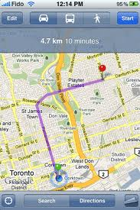
Motivation
Massive amount of spatio-textual objects have emerged in many applications
Road network distance is employed in many key application
e.g., location based service
Strong preference on spatially diversified result
e.g., dissimilarity reasonably large
diversified spatial keyword search on road networks

Slide 4

Motivation Example
Tourist Aim
A nice dinner
Visit nearby attractions or shops
No idea with attractions or shop until some restaurants suggested
Preferred
K close restaurants satisfy dinner requirements
Restaurants welled distributed
Result
P₁, P₄ might be a better choice
Provide more attractions or shops with a slight sacrifice in relevance
K=2, q.T={pancake, lobster}
Notes:
For example, given a set of restaurants in Sydney CBD, whose locations and service lists are showed in figure. Suppose a user want to have a nice dinner and then visit nearby tourist attractions or shop after dinner. Assume he decides to enjoy the lobster and the pancake which are famous in Sydney, but has no idea what kinds of attractions or shops to visit until some restaurants are suggested. He may give a query q with a pancake and lobster, and set the number of k to 2. What he want is 2 restaurants which servers lobster and pancake, and well distributed in this area. Intuitively, the two closest restaurants servers both pancake and lobster are p1 and p2. . However, it is not a good result, the two restaurants are two close, the attractions or shops around them are too similar. Therefore, in this scenario p1, p4 might be a better choice, because is provide more attractions or shops with a slight sacrifice closeness.

Slide 5
Problem Statement
SK Query
Given a road network G, and a set of spatio-textual objects, a query point q which is also a spatio-textual objects, and a network distance δ_{max}, a spatial keyword query retieves objects each of which contains all query keywords of q and is within network distance δ_{max} from q.
T=t1,t2
δ_{max} =20
Result: O₁,O₂,O₈
Notes:
Firstly, I will introduce spatial keyword query. Given a road network G, and a set of spatio-textual objects, a query point q which is also a spatio-textual objects, and a network distance Delta max, a spatial keyword query retieves objects each of which contains all query keywords of q and is within network distance Delta max from q. Here, I will give an example. In this figure, give a query q and a set of keywords t1 and t2, and Delta max which equals to 20. Obviously, o1,o2,o8 will returned by the server. Note that although o3, o4 also in search region, but they do not satisfy the keyword constraint. O9 satisfies keyword constraint, but it is not in search region.

Slide 6
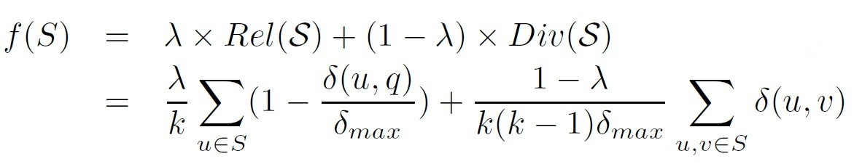
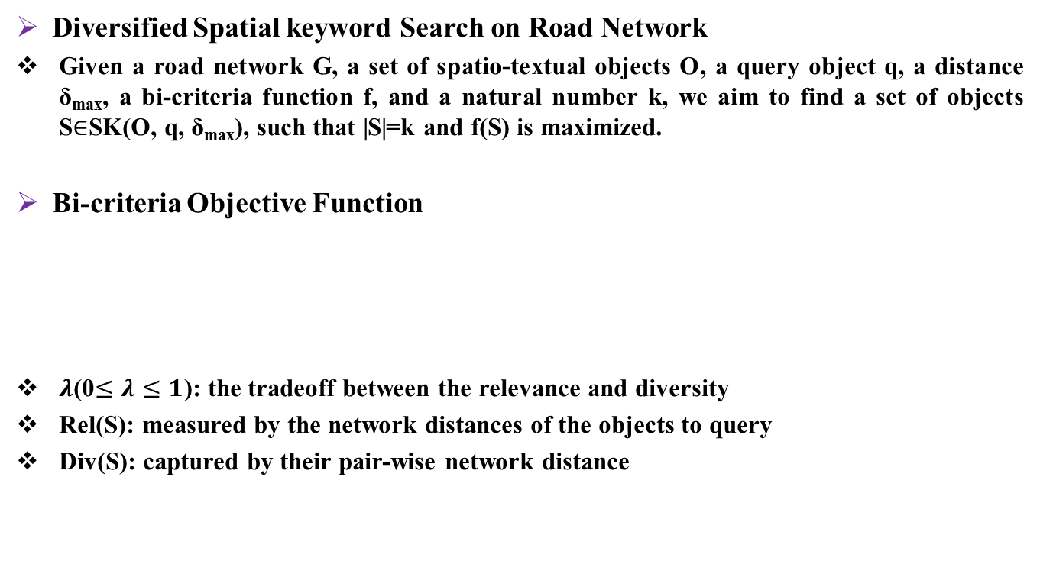
Problem Statement
Diversified Spatial keyword Search on Road Network
Given a road network G, a set of spatio-textual objects O, a query object q, a distance δ_{max}, a bi-criteria function f, and a natural number k, we aim to find a set of objects S$∈$SK(O, q, δ_{max}), such that |S|=k and f(S) is maximized.
Bi-criteria Objective Function
  $λ$(0$≤λ≤1$): the tradeoff between the relevance and diversity
  Rel(S): measured by the network distances of the objects to query
  Div(S): captured by their pair-wise network distance

Slide 7
Example
S₁ = {O₁, O₂}
0.29
S₂ = {O₁, O₈}
0.475
S₃ = {O₂, O₈}
0.465
T=t1,t2
K=2 , δ_{max} =20
λ=0.6
Notes:
Here, I will give an example to explain the problem. Given a spatio-textual road network, and given a query q, and two keyword t1, t2, delta max equals to 20, and lambda equals to 0.6. we aim to a set S which the number of S equals to two, f(S) is maximized. We will first retrieved 3 objects O1, O2, O8, since there are only three objects satisfying spatial keyword constraint and in search region. Because we only required 2 results, but there are three objects, so we need to choose two from them. So we assign them to three group as what is show in figures. Then based on the network detail and bi-criteria function, we calculate their scores. And we find that f(S1) equals to 0.29, f(S2) equals to 0.475, and f(S3) equals to 0.465. Because f(S2) has the maximal value, so the result chosen by diversified SK search is o1 and o8.

Slide 8
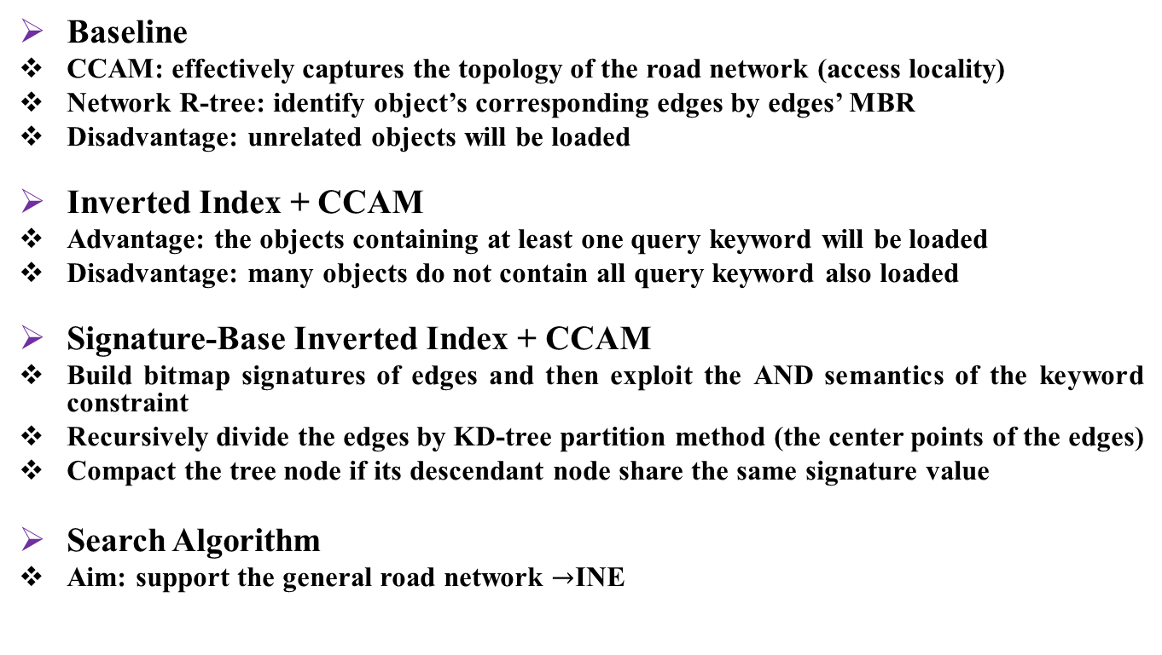
SK Search On Road Network
Baseline
CCAM: effectively captures the topology of the road network (access locality)
Network R-tree: identify object’s corresponding edges by edges’ MBR
Disadvantage: unrelated objects will be loaded
Inverted Index + CCAM
Advantage: the objects containing at least one query keyword will be loaded
Disadvantage: many objects do not contain all query keyword also loaded
Signature-Base Inverted Index + CCAM
  Build bitmap signatures of edges and then exploit the AND semantics of the keyword constraint
  Recursively divide the edges by KD-tree partition method (the center points of the edges)
  Compact the tree node if its descendant node share the same signature value
  Search Algorithm
  Aim: support the general road network $→$INE

Slide 9
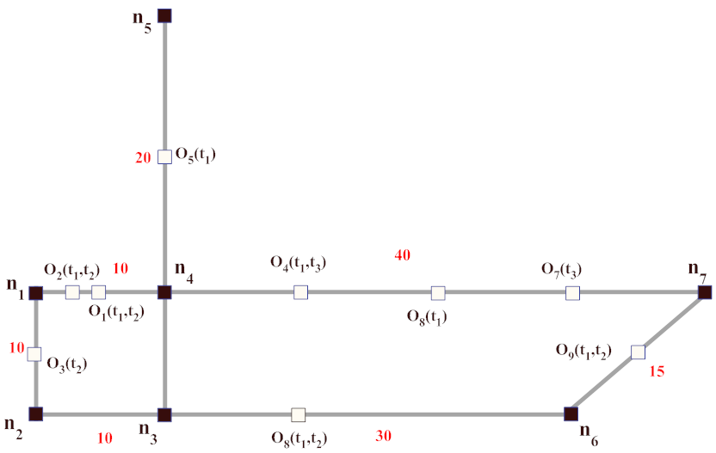
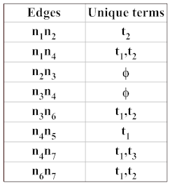
Example
Priority Queue
n₃
n₄
n₁
n₃
n₅
n₅
n₆
n₁
n₂
n₇
n₇
Marked Nodes
n₄
n₃
n₁
n₂
Pass Object
O₁
O₈
O₈
O₂
Marked Object
O₁
O₂
O₈
T=t1,t2
δ_{max} =20
Notes:
Here, I will give an example to explain SK algorithm. Given a spatio-textual road network, and given a query q, and two keyword t1, t2, delta max equals to 20, we want to find all the objects in the search region and satisfy keyword constraint. We will located the edges contained the query location first. And marked the node and add them to the priority queue. Then we dequeue n4, and load the neighbor nodes of n4 by adjanct list add them to priority queue, and check the signature of corresponding edges. Then we find the edges n1n4 satisfy the keyword constraint, so we load the objects in edge n1,n2. And find both O1, and O2 satisfy keyword constraint, so we add them to pass object set. Then we dequeue the n3, and load the neighbor nodes of n3 by its adjanact list and add them to priority queue, and check the correspond edges. We find the edge n3n6 satisfy the keyword constraint, so we load the objects in edge n3,n6. And find both O8satisfy keyword constraint, so we add them to pass object set. Then we dequeue the n1, and do the same progress. Because both node of edge n1n4 are marked node, so we add O1, O2 to result set directly. Then we continue dequeue n2 and add it to marked node set. When the search distance arrive delta max, we will check the object in pass object, to vertify weather it satisfied the distance constraint or not. So the final result is O1, O2 and O8.

Slide 10
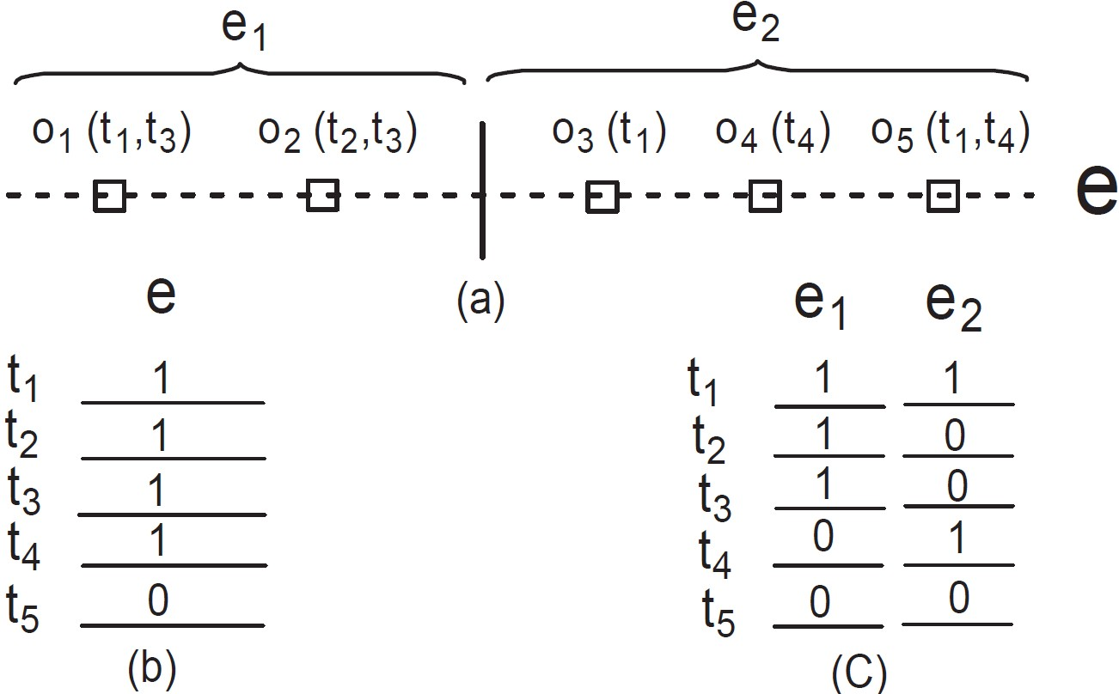
Enhancement of Signature Technique
Observation
Avoid loading objects resulted from false hit
Aim
Find a partition of e with c cuts which has the minimal false hit cost.
Propose a dynamic programming based technique to partition objects lying on an edge.
`Cost- forbidden in practice
Greedy heuristic: at each iteration, find a cutting position which the cost of the refine partition is minimized.
q.T=t₂,t₄
I(e,t₂)=1
I(e₁,t₂)=1
I(e₂,t₂)=0
I(e,t₄)=1
I(e₁,t₄)=0
I(e₂,t₄)=1
Pass test
False hit
Fail test

Slide 11
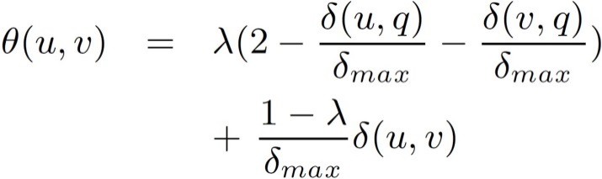
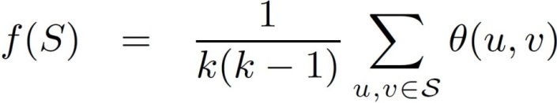
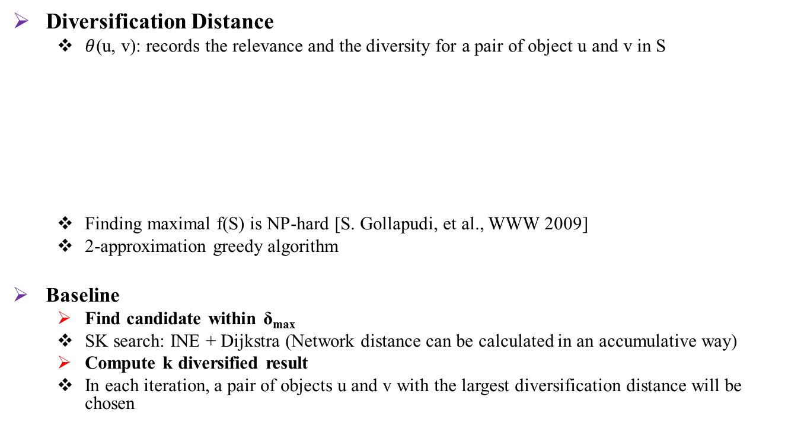
Diversified SK Search On Road Network
  Diversification Distance
  $θ$(u, v): records the relevance and the diversity for a pair of object u and v in S
  Finding maximal f(S) is NP-hard [S. Gollapudi, et al., WWW 2009]
  2-approximation greedy algorithm
  Baseline
  Find candidate within δ_{max}
  SK search: INE + Dijkstra (Network distance can be calculated in an accumulative way)
  Compute k diversified result
  In each iteration, a pair of objects u and v with the largest diversification distance will be chosen

Slide 12
Incremental Diversified SK Search
Drawback
  Invoked diversified algorithm after all objects satisfying spatial keyword constraint are retrieved
  Expensive to compute pair-wise diversification distances, not pre-computation and specific restrictions
  Aim
  prune some non-promising objects based on the diversification distance during search

Slide 13
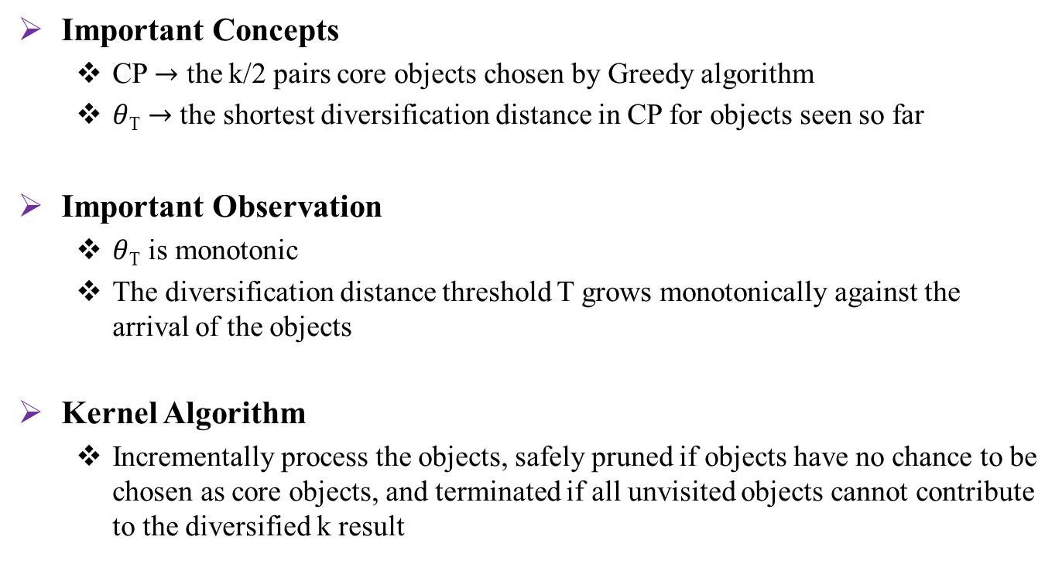
Incremental Diversified SK Search
Important Concepts
  CP $→$ the k/2 pairs core objects chosen by Greedy algorithm
  $θ$_{T} $→$ the shortest diversification distance in CP for objects seen so far
  Important Observation
  $θ$_{T} is monotonic
  The diversification distance threshold T grows monotonically against the arrival of the objects
  Kernel Algorithm
  Incrementally process the objects, safely pruned if objects have no chance to be chosen as core objects, and terminated if all unvisited objects cannot contribute to the diversified k result

Slide 14
Example
Core Pair
O₁
O₄
O₂
Visited object
O₃
O₂
O₅
O₁₇
f(S_{(O1, O2)})=0.99
f(S_{(O1, O3)})=0.96
f(S_{(O2, O3)})=0.97
K=2 , δ_{max} =20
λ=0.6
f(S_{(O1, O4)})=1.09
f(S_{(O2, O4)})=1.08
f(S_{(O3, O4)})=1.07
λ increases, Performance increases
Baseline: 19!
Incremental: 6!
Notes:
Here, I will give an example to explain our algorithm. Given a road network and a set of objects which satisfy the keyword constraint as what is showed in figure. A user give a query q, aim to find a set S which the number of S equals to 2, delta max equals to 20, and lambda equals to 0.6. Based on the algorithm, we will find the first core pair O1, O2, and calculate their score is 1.13. When O3 coming, we calculate the score between (O1, O3) and (O2, O3). Because both value are smaller than the score of O1,O2 , so we do not change the core pair, just add O3 to object list. When O4 coming, we calculate the score between (O1, O4) (O2,O4) and (O3, O4). Because the set (O1, O4) has the largest value 1.18, so we use O4 to replace O2, so the need core pair is (O1,O4). Then we continue this processing on O5, o17. Until the network distance from query increase to 11.7, we find all the unvisited objects cannot contribute to the diversified k result, we terminate the algorithm. Therefore, in this example, for baseline algorithm we access 19 objects, and for our incremental algorithm, we access 6 objects.

Slide 15
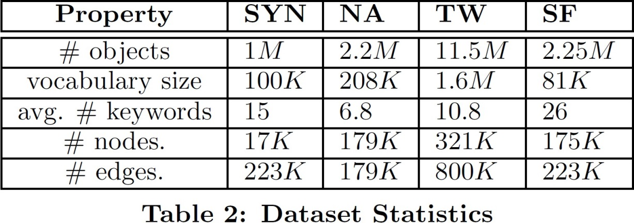
Experimental Setting
Implemented in Java
Debian Linux
  Intel Xeon 2.40GHz dual CPU
  4 GB memory
Dataset
  NA: US Board on Geographic Names + North America Road Network (Default)
  SF: Spatial locations from Rtree-Portal + Textual content randomly generate from 20 Newsgroups + San Francisco Road Network
  TW: 11.5 millions tweets with geo-locations from May 2012 to August 2012 + San Francisco Bay Area Road Network
  SYN: Synthetic Data + San Francisco Road Network

Slide 16
Algorithms Evaluated
IR
  A natural extension of the spatial object indexing method in VLDB2003
IF
  Inverted indexing technique
SIF
  Signature-based inverted indexing technique
SIFP
  Enhanced SIF by partition technique
SEQ
  A straightforward implementation of the diversified spatial keyword search algorithm
COM
  The incremental diversified spatial keyword search algorithm
Query (500) : location , #l query keywords
Evaluate Response time and # I/O

Slide 17
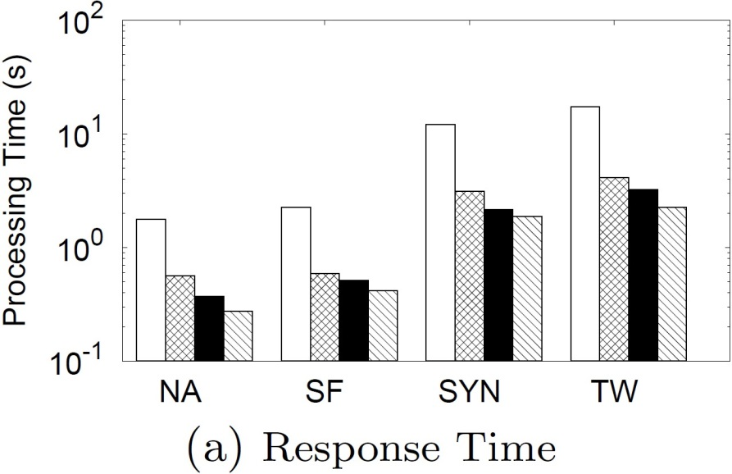
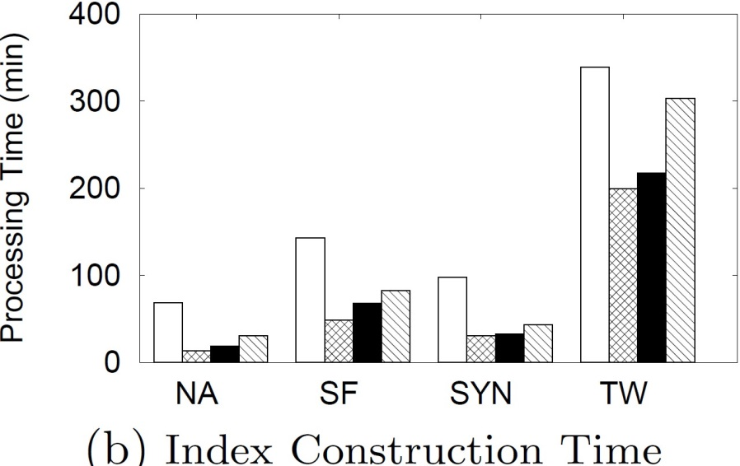
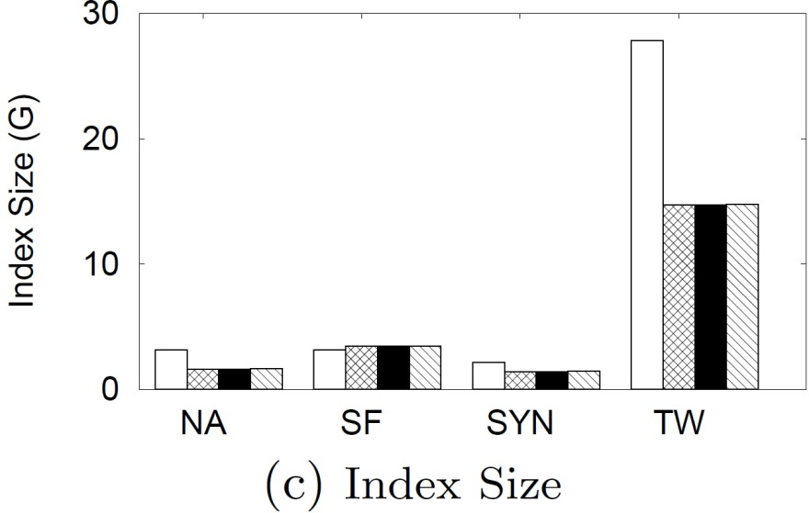
SK Search on Diff. Dataset

Slide 18
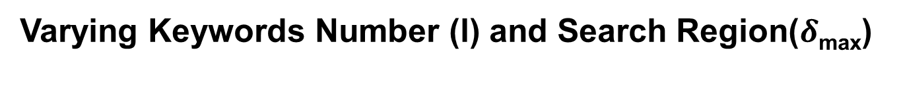
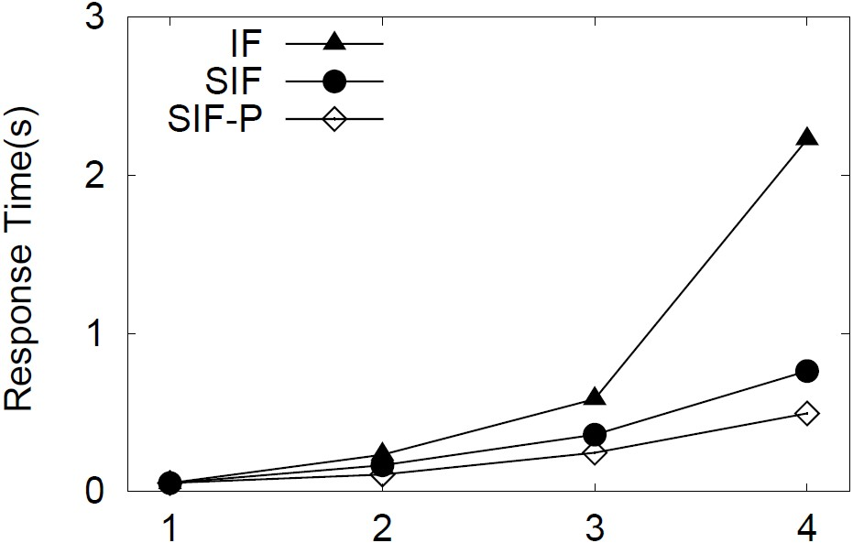
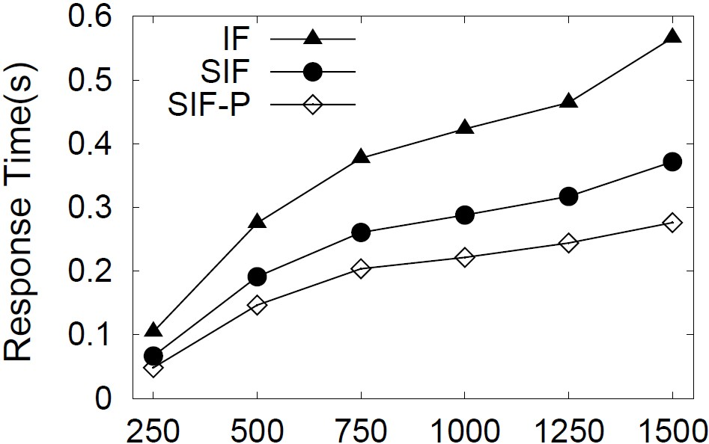
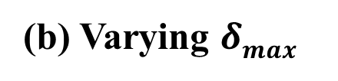
(a) Varying l
(b) Varying $δmax$

Slide 19
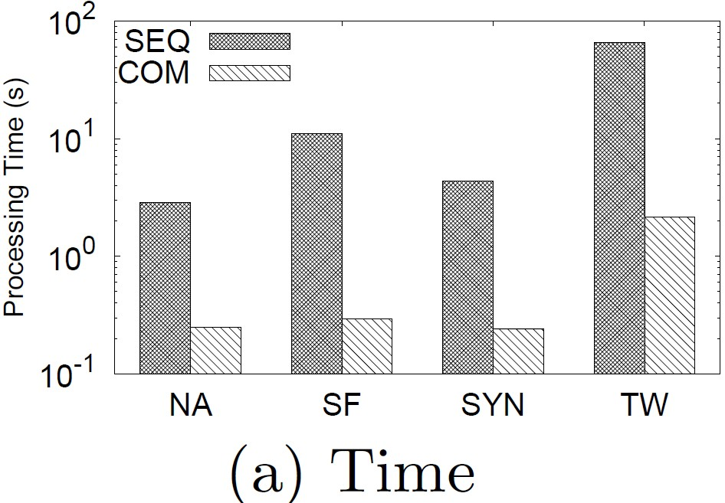
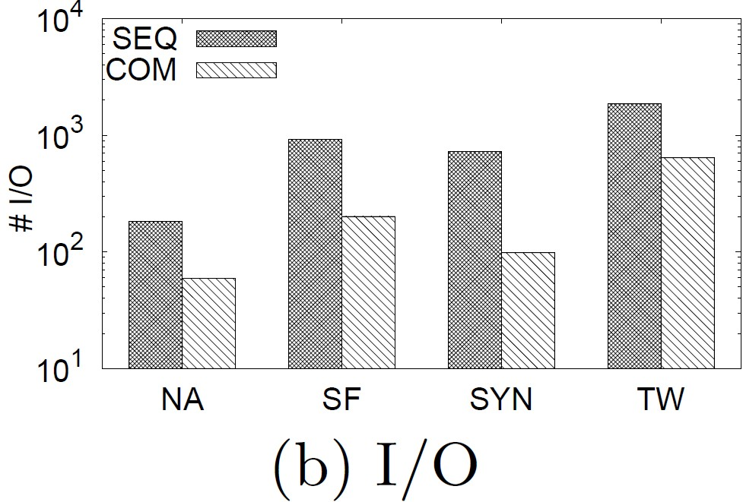
Diversified SK Search on Diff. Dataset

Slide 20
Conclusion
Formally define the problem of diversified spatial keyword search on road networks
Propose a signature-based inverted indexing technique on road network.
Develop effective spatial keyword pruning and diversity pruning techniques to eliminate non-promising objects
Extensive experiment on both real and synthetic data
Future work
Extend to diversified ranked spatial keyword query on road networks

Slide 21

Thank you!

Slide 22
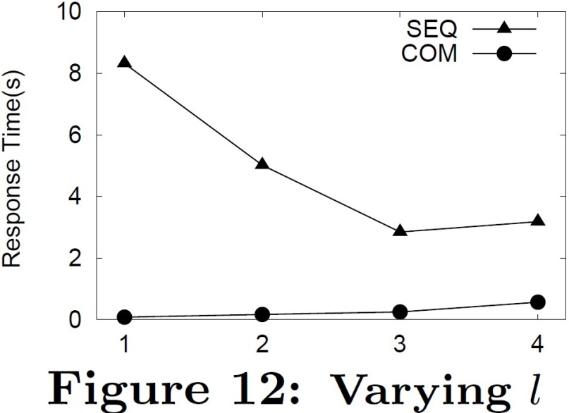
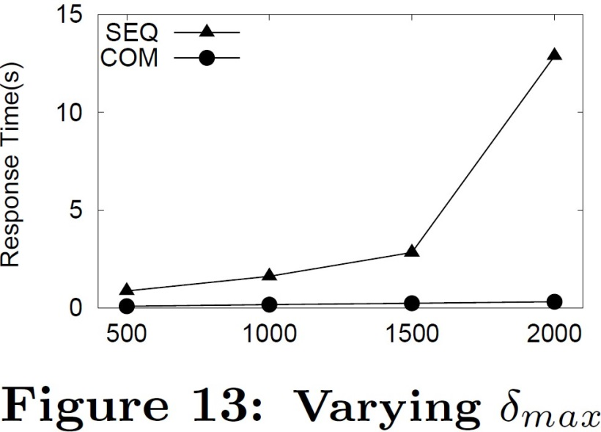
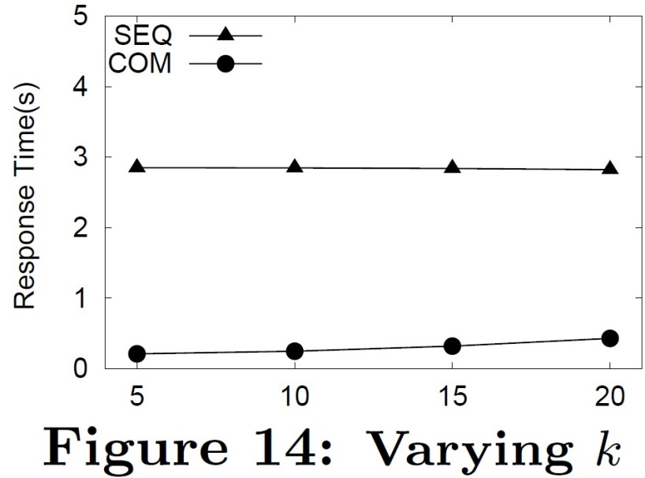
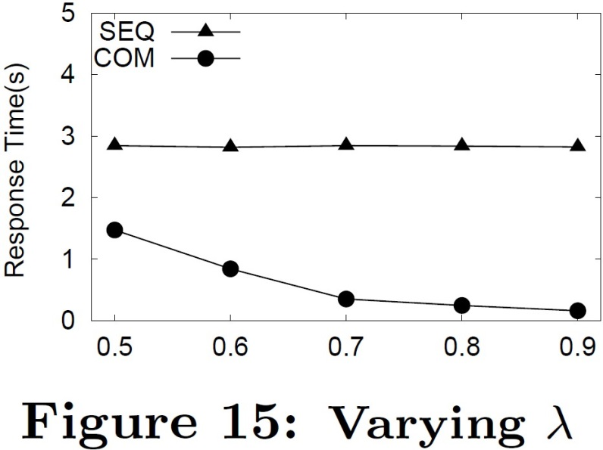
Evaluation on different parameter

