Slide 1

Quantile-Based KNN over Multi-Valued Objects
Wenjie Zhang
Xuemin Lin, Muhammad Aamir Cheema, Ying Zhang, Wei Wang
The University of New South Wales, Australia

Slide 2
KNN Query
Find k objects closest to query q
o₄
o₁
q
o₂
o₃
2-NN of q: o₂ and o₄

Slide 3
KNN Query
Find k objects closest to query q
What if objects have multiple values ?
Player A
Player B
q

Slide 4
Existing Models for Multi-instances
Probabilistic KNN Models
  Probability is computed by summing up probabilities of all valid possible worlds
  Probable top-k NN: [Bekales, Soliman, Ilyas. VLDB 08]
  Probabilistic verifiers: [Cheng, Chen, Mokebel, Chow. ICDE 08]

Slide 5
Probabilistic KNN Model
q
and have the same probability to be NN of q

Slide 6
Probabilistic KNN Model
q
and have the same probability to be NN of q

Slide 7
Probabilistic KNN Model
q
and have the same probability to be NN of q

Slide 8
Probabilistic KNN Model
ties
Not very sensitive to relative distribution of objects instances
Different semantics than multi-value objects !

Slide 9
Aggregate Distances
Existing: mean, minimal, maximal, etc
Generalization: quantile distance

Slide 10
Applications
GIS
Location based service
Radio Frequency Identify Device
…

Slide 11
Contributions
Distance between two multi-value objects
  Quantile distance
  Quantile group-base distance
KNN processing
  Linear time algorithm for quantile distance
  Pruning Techniques on object & instance level

Slide 12
Preliminaries
Φ-quantile:
  The first element in a sorted list with the cumulative weight not smaller than Φ, where Φ is a number in (0, 1].
Sorted elements: 3 6 7 8 8 10 13 15
Weights: .10 .15 .20 .15 .10 .05 .10. .15
Cumulative weight: 0.45
0.5-quantile
0.8-quantile

Slide 13
Preliminaries
Multi-valued Object:
  A set of weighted instances in d-dimensional space
  The sum of the weights equals to 1

Slide 14
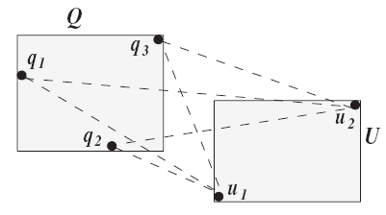
Quantile Distances
Φ-quantile distance
¼
½
½
¼
½
Instance pairs: (q₂, u₁) (q₃, u₁) (q₃, u₂) (q₁, u₁) (q₂, u₂) (q₁, u₂)
Weights: 1/8 1/8 1/8 1/4 1/8 1/4
0.25-quantile
0.5-quantile

Slide 15

Quantile Distances
Φ-quantile group-base distance
  Candidate group: a subset S’ of elements set Q x U such that the total weights of elements in is not smaller than Φ.
  The minimal total weighted distance among all candidate groups, namely with the minimal

Slide 16
Quantile Distances
Φ-quantile group-base distance
Φ = 0.5
Instance pairs: (q₂, u₁) (q₃, u₁) (q₃, u₂) (q₁, u₁) (q₂, u₂) (q₁, u₂)
Weights: 1/8 1/8 1/8 1/4 1/8 1/4

Slide 17
Problem Definition
Given a set of multi-valued objects, a multi-valued query object and Φ in (0, 1], retrieve K objects with smallest Φ-quantile distance and Φ-quantile group-base distance to the query object.

Slide 18
Framework
Seeding
  Select k objects and compute quantile distance --- k seeds are selected based on mean
  Challenge: efficient computation of quantile distances
Refinement:
  Determine the final solution
  Challenge: efficient pruning techniques

Slide 19
Φ-quantile Distance
Multi-value objects U and V
  Overall m=|U| * |V| instance pairs
  Existing: Disk-based Quantile computation: O(mlogm) with pruning
  --- Yiu et al EDBT 06
  Our contribution: O(m) algorithm with pruning
  Basic Idea: index instances by R-tree; prune entry pairs at higher levels using bounding techniques

Slide 20
Φ-quantile Distance
U₂
0.5
0.5
Φ=0.6
U₁
V₁ 0.4
0.6
Φ=0.6 – 0.2
V₂
lower bound
(U₁, V₁) 0.2
(U₁, V₂) 0.3
(U₂, V₂) 0.3
(U₂, V₁) 0.2
upper bound

Slide 21
Φ-quantile KNN
λ_{k}: the largest distance of the K seeded objects
Global R-tree: indexes the MBB of the multi-value objects set
Local R-tree: indexes the instances of multi-value objects (query, object set)

Slide 22
Φ-quantile KNN
Distance based pruning rule on Global R-tree
E
from global R-tree
≥λ_{k}
Q

Slide 23
Φ-quantile KNN
Weight based pruning rule on Global R-tree Entry E:
Let Ω denote the set of entries with minimal distance ≤ λ_{k}, if the total weight of entries in Ω is ≤ Φ, then every object in E could be pruned.
from global R-tree
E
Q
Q₂
minimal distance: mindist(Q₂, E) ≤ λ_{k}
weight(Q2) ≤Φ
Q₁

Slide 24
Φ-quantile KNN
Pruning on the Local R-tree of Q and U
  Trim the local R-tree of both Q and U by λ_{k} level by level. Discard entries in Q with minimal distance to U larger than λ_{k}, similarly for U.
  Denote the total weight of remaining entries as P_{Q} and P_{U}, respectively, if P_{Q} * P_{U} ≤ Φ, then U can be pruned.

Slide 25
Φ-quantile KNN
Pruning on the Local R-tree of Q and U
U
U₂
Q
U₁
Q₂
minimal distance: mindist(Q₁, U) ≥ λ_{k}
minimal distance: mindist(Q, U₂) ≥ λ_{k}
Q₁
weight(Q₂) * weight(U₁) ≤Φ

Slide 26
Φ-quantile KNN
Overall processing
  1. Pruning on Global R-tree based on distance
  2. Pruning on Global R-tree based on weights
  3. Pruning on Local R-tree
  Φ-quantile distance computation

Slide 27
Φ-quantile Group-base Distance
From |Q| * |U| instance pairs, select a set of pairs such that
  the sum of weights is ≥ Φ
  the weighted distance is minimized
Reduced to Knapsack problem. NP-hard

Slide 28
Φ-quantile Group-base Distance
Approximate algorithm with ratio 2 and time complexity O(m log m), where m is the total number of instance pairs.
sorted distance: 1
weight: 0.28
2
0.12
3
0.48
4
0.12
possible solution: 1.72 (1, 0.28), (3, 0.48)
possible solution: 1 (1, 0.28), (2, 0.12), (4, 0.12)

Slide 29
Φ-quantile Group-base KNN
Prune a set of objects on Global R-tree based on distance
E
L
Q
Φ * L ≥ λ_{k}

Slide 30
Φ-quantile Group-base KNN
Prune a set of objects on Global R-tree based on weights
  Traverse the local R-tree of Q
  Sort entry pairs according to lower bound distance at each level of Q

Slide 31
Q
E
Global R-tree
Q₂
Q₃
Q₁
Q₄
Φ = 0.5
0.5-quantile
(1, 0.28)
(2, 0.12)
(3, 0.48)
(4, 0.12)
d1= 1 * 0.28 + 2 * 0.12
d2= 3 * (Φ – 0.28 – 0.12)
If d1 + d2 ≥ λ_{k}, then E could be removed.

Slide 32
Φ-quantile Group-base KNN
Overall Processing
  1. Distance based pruning on Global R-tree
  2. Weight based pruning on Global R-tree
  Φ-quantile Group-base distance calculation

Slide 33
Experiment
Real Dataset
  NBA player statistics
  339, 721 records of 1,313 players
  3 dimension
Synthetic Dataset
  Size: 10, 000 to 50, 000
  Instances: 400 to 2, 000
  Dimension: 2 to 5
  MBB length, spatial distribution, instance distribution, weight distribution …

Slide 34
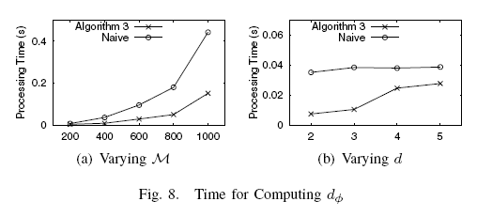
Φ-quantile Distance Computation

Slide 35
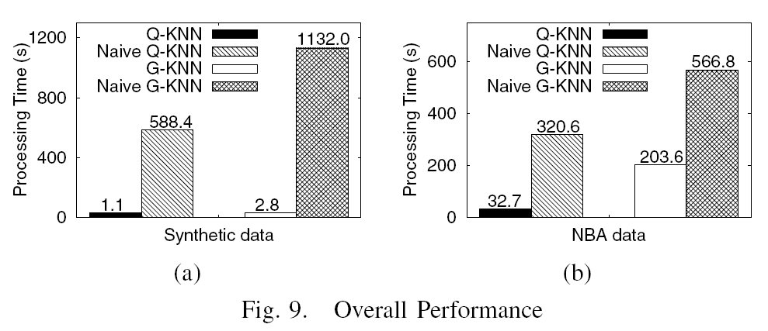
Overall Performance
Naive algorithms refer to techniques without pruning rules

Slide 36
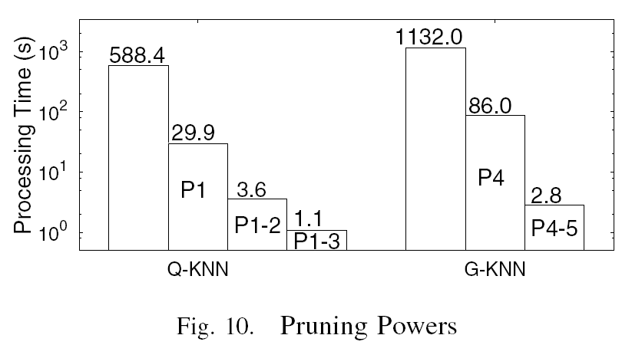
Pruning Powers

Slide 37
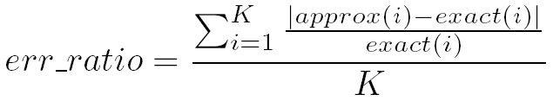
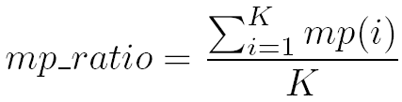
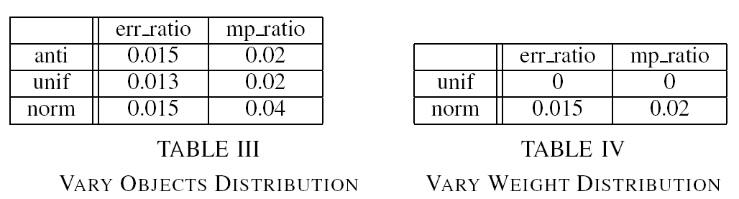
Accuracy

Slide 38
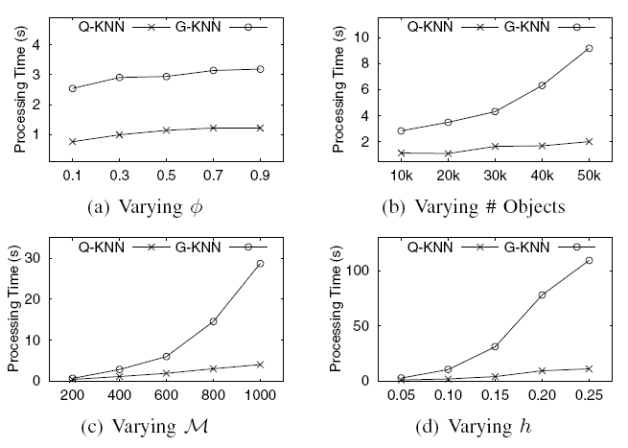
Varying Parameters

Slide 39
Conclusions
Distance between two multi-value objects based on quantile
A linear algorithm for quantile distance computation with pruning
Efficient KNN processing techniques

Slide 40
Thanks

