Slide 1

Reverse k Nearest Neighbors Query Processing:
Experiments and Analysis
Shiyu Yang†, Muhammad Aamir Cheema‡, Xuemin Lin†, Wei Wang†
† The University of New South Wales, Australia
‡ Monash University, Australia
Notes:
Today, I will introduce my research work on RkNN queries which includes two publications, one is regular research paper published at ICDE 2014 and the other one is a experiment paper which published at VLDB 2015 experiment and analysis track. So the title of this talk come to algorithms, experiment and analysis.

Slide 2
Outline
Introduction
Framework
Motivation
Algorithms
  TPL++
Experiments
Conclusion
Notes:
No waste on this page
Here is the outline of my talk.
First, I will briefly introduce what’s RkNN problem and what’s the applications of RkNN queries.
Then, followed by a motivation state to show why we want to do this work.
In the algorithms part, I will introduce some most notable RkNN algorithms which will be evaluated in our experiments and I also present two new algorithms proposed by us. One is SLICE published at ICDE 2014 and the other is an improved version of TPL algorithm named TPL++ which is part of contribution in our VLDB 2015 paper.
After that, I will present a comparison of the algorithms in theoretical analysis part.
Then experiment results will be reported to show the performance of the algorithms
Finally, I will conclude my talk in the last part

Slide 3



Introduction
f₁
Reverse k Nearest Neighbors
  Find every user u for which the query facility q is one of its k-closest facilities
  RNN of f₁ is {u₁,u₂}
  RNN of f₂ is {u₃}
Applications
  Influence computation, marketing, cluster and outlier analysis and decision support systems
u₂
u₁
u₃
f₂
K=1
Notes:
So what’s reverse k nearest neighbors queries?
Suppose we have two sets of objects, one is facility set and the other one is user set.
Since the most of the applications are related to location based services which focus on 2D and Euclidean space.

Slide 4
Framework
Pruning
Verification
Six-regions (SIGMOD 2000)
SLICE (ICDE 2014)
Six-regions (Stanoi et al., UCSB, SIGMOD 2000)
TPL (Tao et al., CUHK, VLDB 2004)
FINCH (Wu et al., NUS, VLDB 2008)
InfZone (Cheema et al., UNSW, ICDE2011)
SLICE (Yang et al.,UNSW, ICDE 2014)
Region-based
Half-space
TPL (VLDB 2004), TPL++ (VLDB2015)
FINCH (VLDB 2008),
InfZone (ICDE 2011)
Notes:
Show all in first !!!!!!
Remove boost
The reverse k nearest neighbors queries have been extensively studied during the last dacade.
Most of the existing techniques follows two phase framework, pruning and verification
In the filtering phase, each algorithm uses the set of facilities to filter the search space that cannot contain any RkNN
of the query. Since using all of the facilities may be prohibitively expensive, the algorithms choose some of the facilities for filtering
the space. These facilities are called filtering facilities
In the verification phase, the users that cannot be filtered using Sfil are retrieved. These are the possible RkNNs
and are called the candidate users. Each of these candidates is then verified by confirming whether it is a RkNN or not.
Among the existing pruning strategies, there two strategies are most notable which are region-based pruning and half-space.

Slide 5
Motivation and Contributions
Motivation
  Reporting overall cost may be misleading
  Buffer size affects the ranking
  All in one comparison
Contributions
  Comprehensive experiments
  Improved TPL algorithm: TPL++
Notes:
The results reported in some of the existing experimental studies (e.g., [20,25]) compare the algorithms on overall cost where
the overall cost includes both CPU cost and I/O cost. The I/O cost is estimated by charging a fixed penalty per disk I/O, for exmaple 10ms/IO.
However, the I/O cost in system dependent, the cost of hard disk and ssd may be quiet different , so simply charge a fixed penalty may not be fair.
We did a experiment to show that the overall cost and ranking may change with the change of I/O penalty.
Some of the algorithms (such as TPL, InfZone and SLICE) access each node of the underlying index (i.e., R*-tree) at most
once. On the other hand, six-regions and FINCH require multiple accesses to some nodes of the R*-tree. Hence, the I/O cost
of these two algorithms is affected by the size of buffer. We note that RkNN queries are not I/O extensive and the number of unique
nodes accessed by the algorithms to answer a RkNN query is small. However, all of the existing experimental studies either use a very small buffer
(10 pages only) or no buffer at all. This adversely affects the performance of six-regions and FINCH especially if a larger penalty
is charged per I/O. So we want to see what’s performance of each algorithm if we give them enough buffer.
In each of the existing experimental studies, the proposed algorithm is only compared with its predecessor assuming that the
predecessor was the state-of-the-art algorithm at that time. The two limitations mentioned above aggravate this because, as argued
above, the predecessor may not necessarily be the best algorithm at the time. Hence, there is a need to conduct a comprehensive experimental evaluation that compares all notable algorithms
By far, I think I have explained why we did such work. Next I will briefly introduce the algorithms compared in our paper and the two algorithms proposed by us.

Slide 6
Algorithms --TPL
Half-space Pruning
  Property of perpendicular bisector
TPL [Tao et al., CUHK, VLDB 2004]
  Sort facilities according Hilbert value
  Draw bisectors between facilities and query
  A point can be filtered if it is in a combination of the half-spaces of k facilities.
  Pruning power <> Pruning cost
c
b
p
q
a
d
u
k=2
Notes:
Next, I will introduce the most popular algorithm for rknn queries that is TPL algorithm proposed by yufei tao at VLDB 2004.
Recall that the half-space pruning is based on the following observation that is the space that is contained by k half-spaces can be pruned.
The TPL algorithm works as follows:
...
After accessing all facilities, the area that is contained by at least k-half-spaces can be pruned. In the example, the area colored in red cannot have any result of q, so it can be pruned safely.
After find the facilities that can contribute one bisector, we can such facilities as filtering facilities. In order to pruned a r-tree node, we need to check which k filitering facilities that prune such node. In TPL, they store all the filtering facilities in a list ordered by their hilbert value. The reasonnale of sorting by hilbert value is because that the facilities with similar hilbert values are closed to each other spatially. And they believe the facilities that close to each other can pruned a larger area. So when pruning a node, TPL algorithm try to find a set of k -consecutive fitering facities which can prune the node togother.
The problem of TPL is that check which k half-spaces prune a node is expensive.

Slide 7
Algorithms --TPL++
Optimisation 1:
  A point can be filtered if it is pruned by k facilities.
  Add a counter for point to be pruned.
  Iterate over facilities.
  O(mk) -> O(m)
Optimisation 2:
  Include more facilities for pruning
c
b
p
q
a
e
k=2
Notes:
Based on this observation, we propose a improved version of TPL named TPL++ with a simple yet powerful pruning strategies.
Our TPL++ is based the following two optimizations that's why we have two ++ after TPL.
The first optimization is that instead of find a set of k consecutive frittering faculties, we add a counter to the node need to be pruned. We will increse the counter by one when we find one filtering facility that can prune this node. When the counter is equal to k, it means there are already k filtering facilities that can prune this node. Note that, these k filtering facilities are not nessorerily close to each other.
Another optimization is that: we include more facilities for pruning. Note that the size of Sfil directly affects the cost of filtering as well as the filtering power of the algorithm. TPL only keeps the facilities that cannot be filtered using the existing filtering facilities. Specifically, similar to TPL, if an ac- cessed entry e is an intermediate or leaf node and can be filtered, we ignore it. However, if an accessed entry e is a facility, we insert it in Sfil regardless of whether it can be filtered or not. Note that this in- creases the size of Sfil for TPL++ and, in effect, increases the filtering cost. However, it results in a much better filtering power which results in requiring fewer calls to the filtering algorithm.
Also, in contrast to TPL, we do not need to check whether the facility can be filtered or not which further reduces the number of times filter- ing algorithm is called. As a consequence, the I/O cost as well as the CPU cost of the algorithm is reduced.
Our experiments show that TPL++ is up to 20 times better than TPL in terms of CPU cost and up to 2 times better in terms of number of I/Os.

Slide 8
Effect of Optimisations
2 times better
20 times better

Slide 9
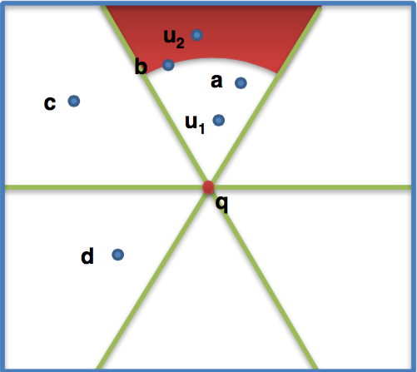
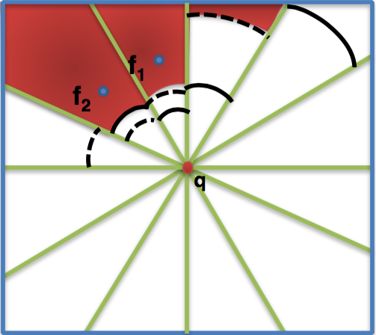
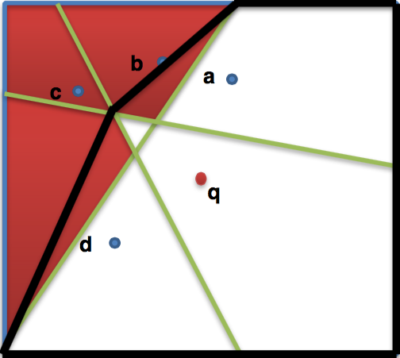
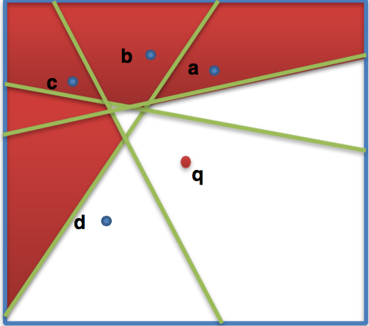
Algorithms
Region-based Pruning
Half-space Pruning
Six-regions
SLICE
FINCH
InfZone
Stanoi et al., UCSB,
SIGMOD 2000
Yang et al., UNSW,
ICDE 2014
Wu et al., NUS,
VLDB 2008
Cheema et al., UNSW,
ICDE 2011
Notes:
Add affiliation for all algorithms
The first region based pruning approach was proposed by Stanoi at Sigmod 2000. The proposed the six-regions algorithm which partition the space around q in six equal regions each angle range of 60 degree.
The key idea is that, The k-th nearest facility of q in each region defines the area that can be filtered. In other words, any user lies in this partition and lies at a distance greater than the distance of k-th nearest facility in that region cannot be the rnn of q.
Based on this observation, their proposed algorithm works as following.
For any user which lies in the unpruned area will be verified by a range query with the range set to the distance between u and q. And count how many facilities are in the range. If there are more than k facilities in this range then such user cannot be the rknn of q.
The bottleneck of six-regions approach is that the verification phase which incurs multiple access of r-tree and increase both I/O and CPU cost.

Slide 10
Experiments
Setup
  Intel Xeon 2.66 GHz CPU, 4GB Memory and Hard disk
  Index: R*-tree
  100 buffers
  I/O cost and CPU cost
  Average cost per query
Data sets
  Three real data sets (up to 25M points)
  CA, LA and NA
  Synthetic data sets follows different distributions (up to 20M points)
Source code and data sets are available online

Slide 11
Experiments
Ranking
Criteria | 1st | 2nd | 3rd | 4th | 5th | 6th
I/O (no buffer) | TPL++,InfZone |  | SLICE | TPL | FINCH | SIX
I/O (small buffer) | TPL++,InfZone |  | FINCH | SLICE | TPL,SIX
CPU (k<10) | SLICE | InfZone | TPL++ | FINCH | SIX,TPL
CPU (10<k<25) | SLICE | InfZone, TPL++ |  | FINCH | SIX | TPL
CPU (25<k<200) | SLICE | TPL++ | SIX | FINCH | InfZone | TPL
Implementation | SIX,SLICE |  | TPL, TPL++ |  | FINCH, InfZone
Notes:
Remove all exp figures
Color!!!
Buffer effect!!!
Table 2 provides rankings of the algorithms under different experimental settings. Although the table is self-explanatory, we provide a few comments. In terms of I/O cost, TPL++ and InfZone are the best algorithms. Specifically, TPL++ generally performs better than InfZone when the facilities data set is larger or equal to the users data set. On the other hand,
InfZone performs better when the users data set is larger. In terms of CPU cost, SLICE is the best algorithm for all values of k. Inf-
Zone is the second best algorithm for smaller values of k whereas TPL++ is the second best algorithm for larger values of k.
We also rank the algorithms considering the ease of implementation. Note that this ranking is based on our personal experience and
is subjective. SIX and SLICE are the easiest to implement because the half-space based filtering is generally more complicated to implement.
FINCH and InfZone are more difficult to implement than TPL and TPL++ mainly because these algorithms require updating
the polygons as well as the counters of intersection points of the half-spaces.

Slide 12
More in the paper
Lower bound algorithm
Complexity
Pruning | Six-regions | TPL | TPL++ | FINCH | InfZone | SLICE
node | O(1) | O(km) | O(m) | O(m) | O(m) | O(t)
point | O(1) | O(km) | O(m) | O(logm) | O(m) | O(1)
Add | O(log k) | O(logm) | O(logm) | O(m²) | O(m²) | O(tlogm)
Verification
node | O(1) | O(km) | O(m) | O(m) | O(m) | O(t)
point | O(1) | O(km) | O(m) | O(logm) | O(logm) | O(1)
Verify Cand | Range query | Range query | Range query | Range query | O(logm) | O(m)
Notes:
Explain m t k !!!!
After introducing the algorithms compared in our experiments, I will present a overview of the complexity of these algorithms.
In this table, I list the complexity of some important operations which are used in all these algorithms. It looks a little bit messy, I will pick up some interesting results to introduce.
Before that, I will clarify some notations first. The m here is number of facilities that are used as filtering facilities, since different algorithms use different set of filtering facilities so the value of m is different for each algorithm. And, the t is number of partitions used in SLICE. Second, the low complexity shown in the table may not mean that the overall cost is low, since it also depends the number of times each algorithms is called.
In the filtering phase, Six-regions and SLICE have the cheapest pruning cost, this is because the region-based pruning only need one distance comparison. But the pruning power of six-regions is poor as we shown in previous slides
When add a new facility into the filtering facility set, FINCH and InfZone have the largest complexity as they have to update the convex polygon and infzone accordingly, which have been proved time complexity of O(m2).
In the verification phase, the cost of pruning a user point or node is similar pruning a facility point or node in filtering phase.
The candidate verification cost of infzone and slice is the smallest as they use a smart strategy to verify a set of candidates.
And what about the performance of the algorithms in empirical studies

Slide 13
Conclusion
Review of existing RkNN algorithms
An improved version of TPL: TPL++
Experiments and analysis

Slide 14
Thanks :)
Q&A

