Slide 1

RELAXED REVERSE NEAREST NEIGHBORS QUERIES
Arif Hidayat
Muhammad Aamir Cheema
David Taniar

Slide 2
Outline
Motivation
Problem Definition
Technique
Experiment
Conclusion

Slide 3
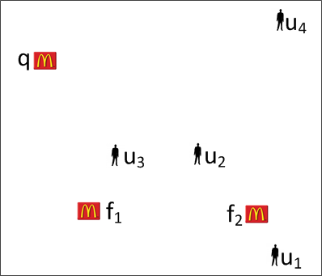



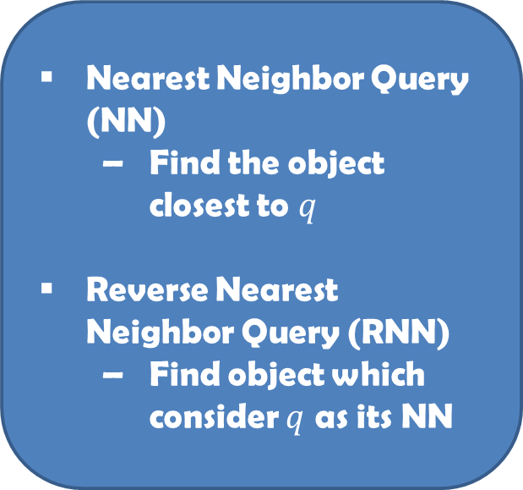

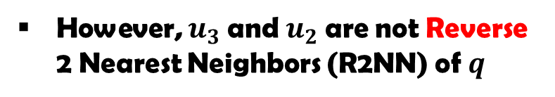
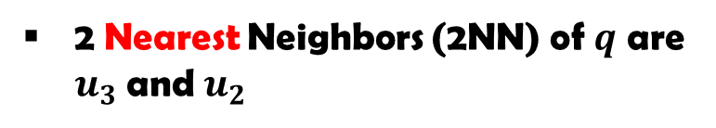
RkNN Query
Nearest Neighbor Query (NN)
  Find the object closest to $q$
Reverse Nearest Neighbor Query (RNN)
  Find object which consider $q$ as its NN
2 Nearest Neighbors (2NN) of $q$ are $u_{3}$and $u_{2}$
However, $u_{3}$and $u_{2}$are not Reverse 2 Nearest Neighbors (R2NN) of $q$
R2NN of $q$ is $u_{4}$

Slide 4
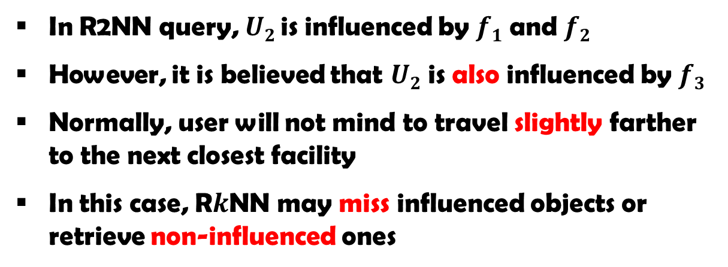
Motivation
In R2NN query, $U2$ is influenced by $f1$ and $f2$
However, it is believed that $U2$ is also influenced by $f3$
Normally, user will not mind to travel slightly farther to the next closest facility
In this case, R$k$NN may miss influenced objects or retrieve non-influenced ones

Slide 5
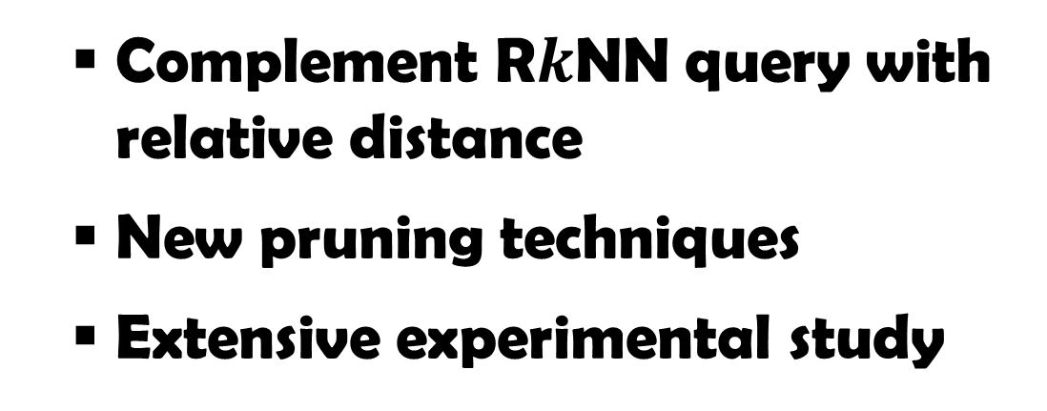
Contribution
Complement R$k$NN query with relative distance
New pruning techniques
Extensive experimental study

Slide 6
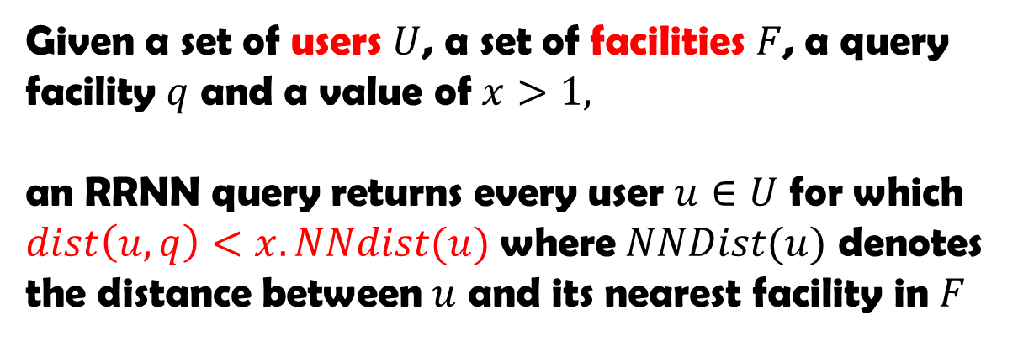

RRNN-Problem Definition
Given a set of users $U$, a set of facilities $F$, a query facility $q$ and a value of $x>1,$
an RRNN query returns every user $u∈U$ for which $dist\left(u,q\right)<x.NNdist(u)$ where $NNDist(u)$ denotes the distance between $u$ and its nearest facility in $F$
1.5 km
$$x=1.5$$
1 km

Slide 7
RRNN-Pruning
Compute regions on which users cannot be RRNN of q
Six-regions and half-space pruning not applicable in RRNN problem
New pruning rule

Slide 8



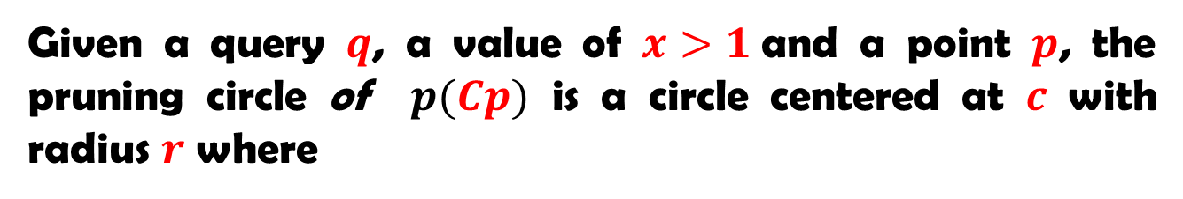



Point-based Pruning
Given a query $q$, a value of $x>1$and a point $p$, the pruning circle of $p(Cp)$ is a circle centered at $c$ with radius $r$ where
$c$ is on the line passing through $q$and $p$
$dist(q,c)>dist(p,c)$
$dist\left(q,c\right)=\frac{x^{2}.dist(q,p)}{x^{2}−1}$
$r=\frac{x.dist(q,p)}{x^{2}−1}$
Proof:
$qcu$ and $pcu$

Slide 9
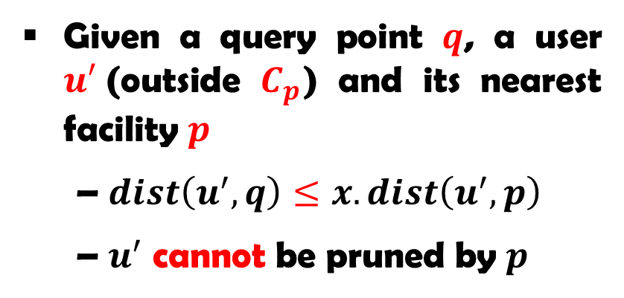
Point-based Pruning
The pruning rule is tight (proof is in the paper)
Given a query point $q$, a user $u′$(outside $C_{p}$) and its nearest facility $p$
$dist\left(u^{′},q\right)≤x.dist\left(u^{′},p\right)$
$u^{′}$ cannot be pruned by $p$

Slide 10
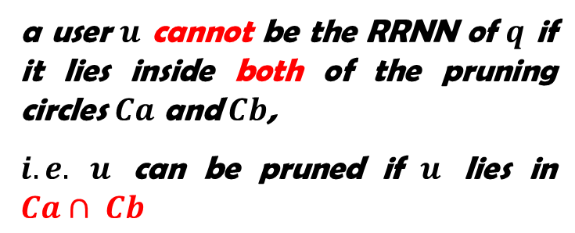
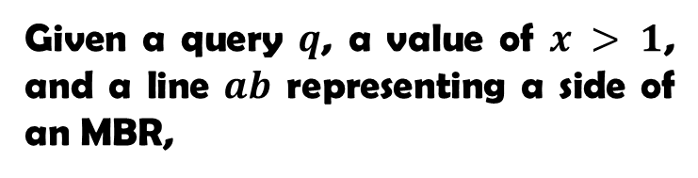
MBR-based Pruning
Given a query $q$, a value of $x > 1$, and a line $ab$ representing a side of an MBR,
a user $u$ cannot be the RRNN of $q$ if it lies inside both of the pruning circles $Ca$ and $Cb$,
$i.e.$ $u$ can be pruned if $u$ lies in $Ca∩ Cb$

Slide 11
Filtering
Prune users using defined pruning regions
RRNN Candidates
Our approach:
Define interval for each pruning region
Build interval tree for each partition
Check users against overlapped interval
O(log n + k)
Straightforward approach:
Store pruning regions in a list
Check user against entries in the list
O(n)

Slide 12
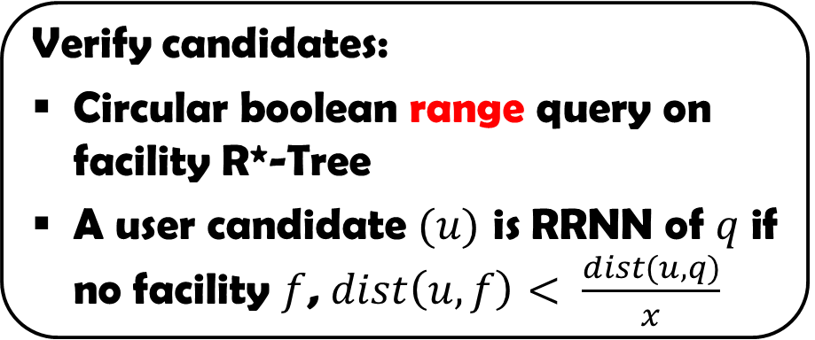
Verification
Verify candidates:
Circular boolean range query on facility R*-Tree
A user candidate $(u)$ is RRNN of $q$ if no facility $f$, $dist\left(u,f\right)< \frac{dist(u,q)}{x}$
More techniques:
Computing interval
Trimming

Slide 13
Experiment Design
Implemented in C++
Run on Intel Core I5 2.3GHzx4 PC with 8GB memory running on Debian Linux
Users and facilities are indexed with R*-Tree
Each experiment runs 100 queries
Parameter | Values
Data size | 2K, 200K, 2M, 20M
x factor | 1.1, 1.3, 1.5, 2, 4
Real data set | NA, LA, CA

Slide 14
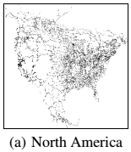
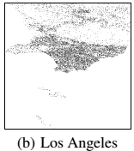
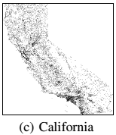
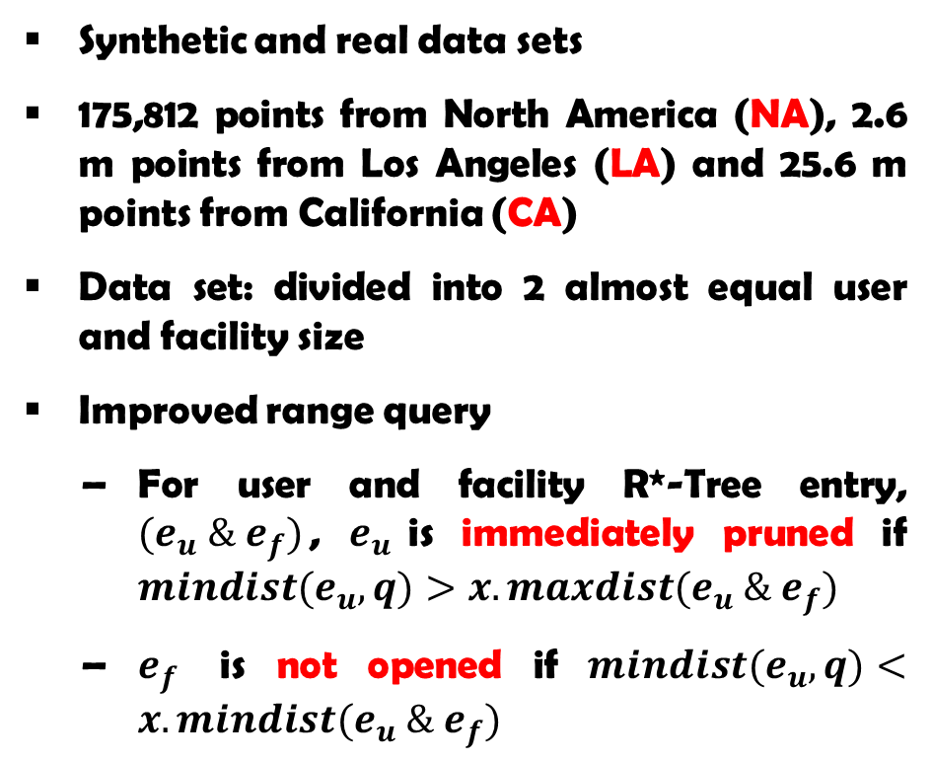
Experiment Design
Synthetic and real data sets
175,812 points from North America (NA), 2.6 m points from Los Angeles (LA) and 25.6 m points from California (CA)
Data set: divided into 2 almost equal user and facility size
Improved range query
For user and facility R*-Tree entry, ${(e}_{u} \& e_{f})$, $e_{u}$is immediately pruned if ${mindist(e}_{u}, q)>x.maxdist(e_{u} \& e_{f})$
$e_{f}$ is not opened if ${mindist(e}_{u}, q)<x.mindist(e_{u} \& e_{f})$

Slide 15
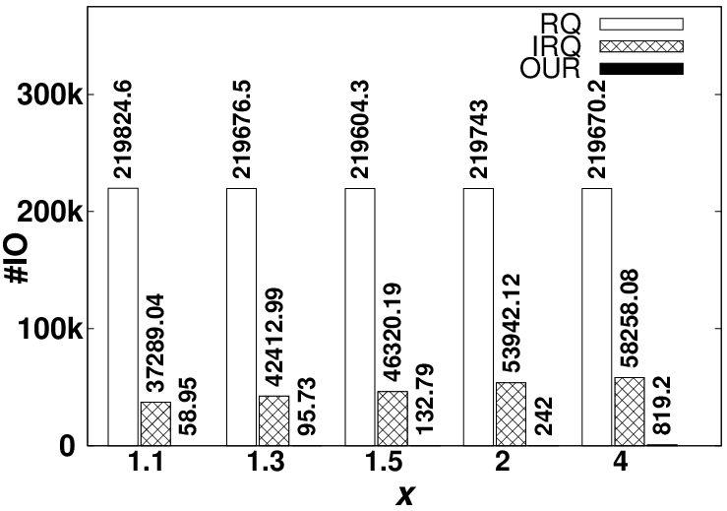
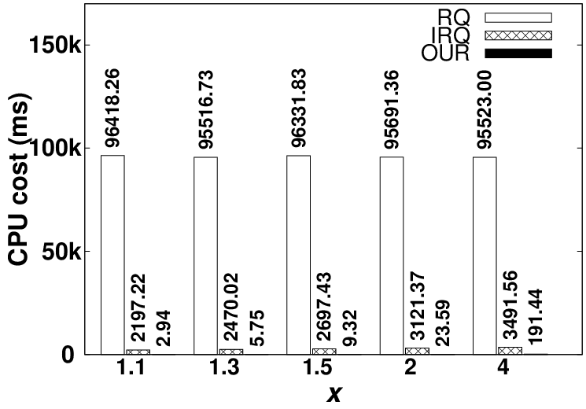
Experiment Results
No previous method for RRNN problem
We compare with naïve range query and improved algorithms

Slide 16
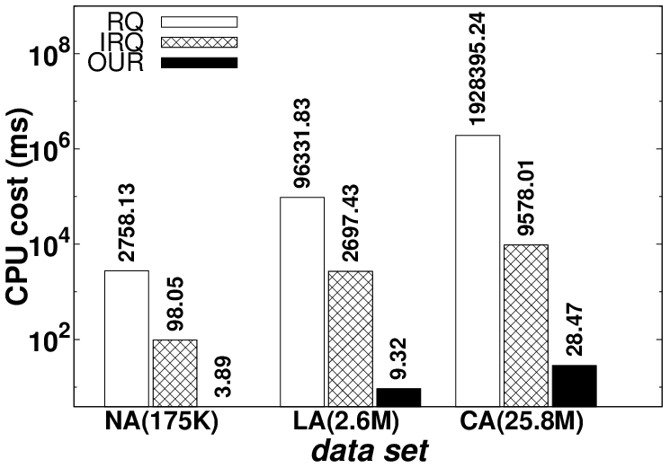
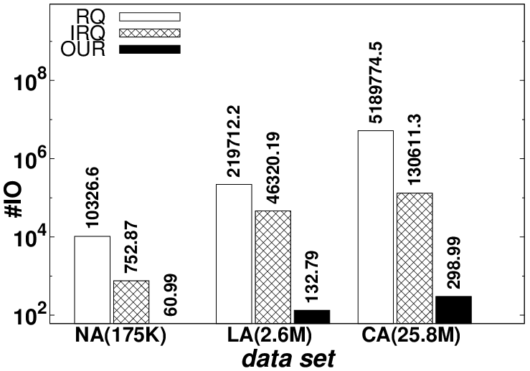
Experiment Results
Our algorithm is several orders of magnitude better than improved algorithm

Slide 17
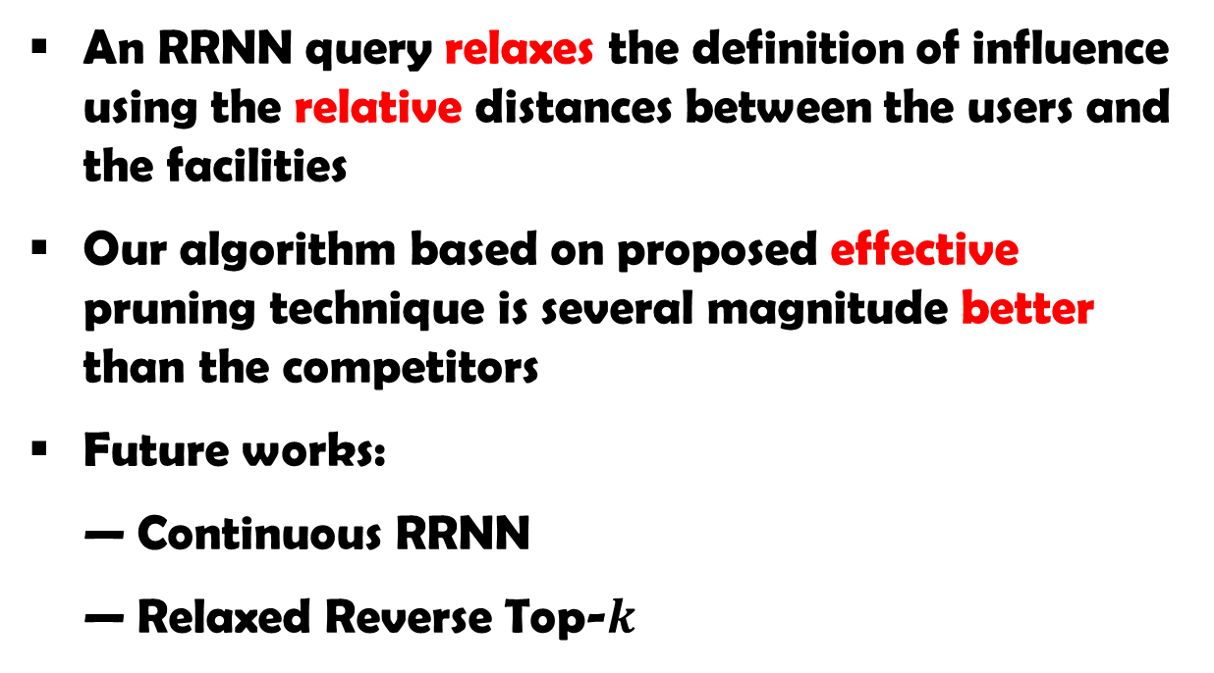
Conclusion
An RRNN query relaxes the definition of influence using the relative distances between the users and the facilities
Our algorithm based on proposed effective pruning technique is several magnitude better than the competitors
Future works:
Continuous RRNN
Relaxed Reverse Top-$k$

